Slide 1
Applying for Research Grants in 2022
Siret Rutiku, PhD
Head of the Office of Research Funding
4 March 2022

Slide 2
In 2022, it is possible to apply for
postdoctoral grants (outgoing) (PUTJD, up to 3 years)
starting grants (PSG, up to 5 years)
team grants (PRG, up to 5 years)
Submission of applications via ETIS from 1 to 31 March at 5 p.m.
NB! The application is submitted only after the institution has confirmed it via ETIS. Please follow the deadlines of your institution. (EULS few days before the deadline, TLU 28.03, TalTech 21.03, UT 24.03)
NB! Read the materials on the website of the Council!
Notes:
EULS = Estonian University of Life Sciences
TLU = Tallinn University
TalTech = Tallinn University of Technology
UT = University of Tartu

Slide 3
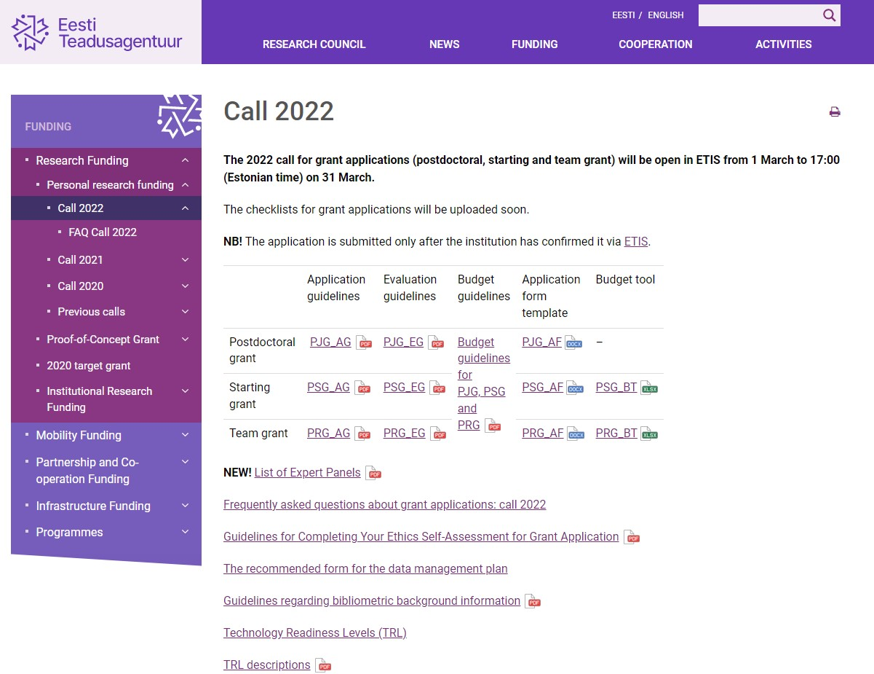
https://www.etag.ee/en/funding/research-funding/personal-research-funding/call-2022/

Slide 4
General principles
The applicant must be the PI of the project.
Grants are for capable researchers from all countries.
For the PI (grant holder), an employment contract with a positively evaluated Estonian R&D institution is obligatory.
Starting grant and team projects have to be implemented in Estonia.
It is not allowed that the same person is the PI and the member of the research staff of several grant applications* or projects.
Fixed grant amounts are used.
Notes:
* It is allowed to be member in more than one grant application when the participation periods do not overlap. E.g. In grant application X, the participation periood is 2023-2024, but in grant application Y, the participation periood is 2025-2026.

Slide 5
Thresholds
Qualification threshold is at least “good“/3 points or “appropriate“/1 point in each evaluated criterion.
In 2022, a person cannot apply for the grant if
- his/her application has failed to reach the qualification threshold in at least one evaluation criterion in two consecutive calls (2020, 2021);
- his/her application submitted during the previous call (2021) did not pass the qualification threshold in at least two evaluation criteria.
Quality threshold is the minimum final score of the application which enables the application to qualify for funding; no restrictions when it comes to submitting a new application.

Slide 6
Applicant of the postdoctoral grant…
…has received his/her PhD at an Estonian university by 31 December 2022 at the latest, but not earlier than on 1 January 2017,
…has lived, worked, or studied in Estonia for at least one year before 31 March 2022,
…wishes to gain research experience outside Estonia,
…is ready to begin with the project on 1 July 2023 at the latest*,
…will enter into an employment contract with an Estonian R&D institution for the duration of the project,
…is neither applying for a starting or team grant nor included as a member of the (senior) research staff in a starting or team grant application,
…has passed the qualification threshold in previous calls.
Notes:
* In justified cases, it is possible to request a later start date of the project than 1 July 2023, but in this case the end date of the project will not be extended.

Slide 7
Applicant of the starting grant…
…has received his/her PhD between 1 January 2016–1 January 2021,
…has gained research experience in a foreign country after obtaining the PhD,
…is ready to begin with the project on 1 January 2023*,
… will enter into an employment contract with an Estonian R&D institution on a full-time basis for the duration of the project and with a place of work in Estonia,
…is neither applying for a postdoctoral or team grant nor included as a member of the (senior) research staff in a starting or team grant application,
…has passed the qualification threshold in previous calls.
Notes:
* In case of a later start date, the end date of the project will not be extended.

Slide 8
Applicant of the team grant…
…is ready to begin with the project on 1 January 2023*,
… will enter into an employment contract with an Estonian R&D institution on a full-time basis** for the duration of the project and with a place of work in Estonia,
…is neither applying for a starting or another team grant nor included as a member of the research staff in a starting or team grant application,
…does not participate in an ongoing starting grant or team project that will continue in 2023,
…has passed the qualification threshold in previous calls.
Notes:
* In case of a later start date, the end date of the project will not be extended.
** In justified cases, it is possible to apply for an exception for leading the project while working at the institution on a part-time basis (minimum 0.2).

Slide 9
Who can participate in the project?
The postdoctoral project is an individual project.
In the starting grant project, other members of the (senior) research staff can* participate if
- they have the necessary qualification for carrying out the tasks;
- they are working or studying at the same institution.
NB! The salary of the PI and senior staff must be fully or partially covered from the grant.
In the team project, it is obligatory to involve other members:
senior staff members have to have a PhD;
(senior) staff can work at another Estonian R&D institution;
the salary of the senior staff must be fully or partially covered from the grant.
The members of the other research staff can be students as well as academic and non-academic staff members without a PhD whose work is related to the topic of the project.
Notes:
*In the PSG application, other participants are not obligatory but it is expected that the PI of a starting grant will form a research group.
**In the PRG application, it is obligatory to have at least 3 team members (1PI+2) from the beginning.

Slide 10
Fixed Grant Amounts
A grant consists of
direct costs, incl.
staff costs (salaries with taxes, scholarships);
research costs (incl. subcontracting costs, costs related to the (open access) publication and popularisation of the R&D results, costs related to the protection of intellectual property, travel costs, costs related to moving to and/or visiting the collaborating institution (in case of PUTJD projects) and other costs that stem from the characteristics of the project);
overhead costs (PUTJD 5%, PSG and PRG 25% of direct costs).
Based on the estimated direct costs and on the specifics of the research, postdoctoral grants are divided into two fixed grant amounts (I and II) per year.
Starting and team grants are divided into four different fixed grant amounts (I, II, III, and IV) per year.
NB! Additional conditions have been laid down if applying for the large PSG or PRG grant amount (III or IV).
Notes:
The size of the salary shall be determined by the institution.
The institution is also responsible for keeping an eye on the accounting records of the grant.
Fixed grant amounts (incl. overhead):
PUTJD I 54,000; PUTJD II 57,000;
PSG I 72,000; PSG II 76,000; PSG III 110,000; PSG IV 117,000;
PRG I 168,750; PRG II 183,250; PRG III 237,875; PRG IV 257,125

Slide 11
In the application…
The files that can be attached to the justification part of the application as PDF files are as follows:
the list of references;
timetable (e.g., Gantt chart, incl. deliverables and milestones);
risk assessment and mitigation plan and a back-up plan.
It is not allowed to add any external links to the application that direct the reader outside ETIS.

Slide 12
Evaluation of PUTJD applications
Postdoctoral grant applications will be evaluated by a separate Expert Panel.
The applicant and the institution are entitled to make objections regarding the preliminary final evaluation (the so-called hearing approximately at the beginning of June).
The applications that have passed the quality threshold will be forwarded to the Panel on Research Ethics and Data Management, which will evaluate the application in terms of research ethics and research data management.
The Evaluation Committee will confirm the final evaluations and make the proposals to approve the applications (approximately by the end of September).

Slide 13
Evaluation of PSG and PRG applications
Starting and team grant applications will first be evaluated in 17 Expert Panels that are based on seven research fields (see the list on the website of the Council).
The applicant and the institution are entitled to make objections regarding the preliminary final evaluation (the so-called hearing approximately at the end of August).
The Evaluation Committee will decide which applications that have passed the quality threshold will be forwarded to the Panel on Research Ethics and Data Management, which will evaluate the application in terms of research ethics and research data management.
The Evaluation Committee will confirm the final ranking lists of each Expert Panel and will make the proposals to approve the applications in seven research fields (approximately at the end of October/beginning of November).

Slide 14
Tips for applicants
Read the relevant application guidelines, evaluation guidelines, checklist for applications, and budget guidelines that can be found on the website of the Council. NB! Neither the information on these slides nor in the FAQ section is complete!
If something remains unclear, then please ask for help.
Compile the application in accordance with the guidelines. Add only the files which are allowed. The limitations on the number of characters apply to all applicants.
All the members of the research staff have to update their ETIS CV.
Make sure that the data of your publications is correct (see the bibliometrics guidelines on the website of the Council).

Slide 15
If you have any questions regarding the application
Research Funding Officers:
Medical and Health Sciences; Agricultural and Veterinary Sciences:
Ade Kallas-Kivi (tel 731 7366, ade.kallas-kivi@etag.ee)
Biological and Environmental Sciences:
Helen Post (tel 731 7363, helen.post@etag.ee)
Exact Sciences:
Raili Torga (tel 731 7358, raili.torga@etag.ee)
Engineering and Technology:
Julia Uusna (tel 731 7367, julia.uusna@etag.ee)
Humanities and the Arts:
Hele Priimets (tel 730 0326, hele.priimets@etag.ee)
Social Sciences:
Eveli Laats (tel 731 7364, eveli.laats@etag.ee)
Head of the Office:
Siret Rutiku (tel 731 7381, siret.rutiku@etag.ee)
Notes:
If something concerning the procedures at your institution is unclear (regulations concerning the salary, contracts, etc.), then please contact the Research Administration Office/Grant Office of your institution.
If you have any questions regarding the application process or you have some field-specific questions, then please contact the Research Funding Officer of your research field.

