Slide 1
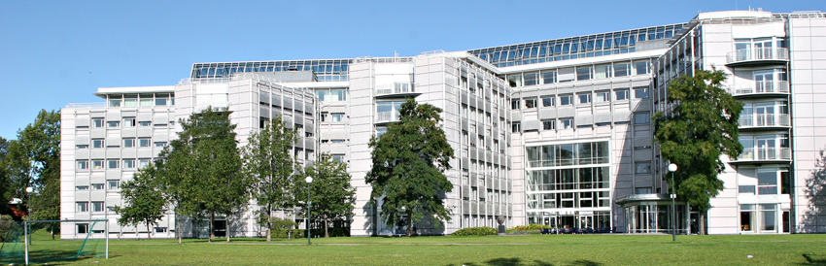
Norwegian-Estonian Research Cooperation Views from programme partner perspective
Senior Adviser, Birgit Jacobsen

Slide 2
The role of the Research Council of Norway
Adviser to the government
Research funding
Networking and dissemination
Internationalization

Slide 3
Public support for research
Higher
education
sector
Ministry of Education and Research
The Research Council
Research performing
organizations
Other Ministries
Industry

Slide 5
EEA and Norway Grants for bilateral research cooperation
13
11
2012-2017: EUR 130 mill
Ongoing programs: Latvia - Norway
Estonia - Norway
Poland - Norway
Czech Republic- Norway
Romania-Norway/Iceland
75
23
23

Slide 6
My presentation
Estonian-Norwegian partners
Horizon 2020 and results
Working together - impressions

Slide 7
The partners
University of Tallinn
University of Tartu
Tallinn University of Technology
Estonia University of Life Sciences
University of Bergen
University of Stavanger
University of Tromsø
University of Oslo
University Centre in Svalbard
Norwegian Forest and Landscape Institute
Norwegian University of Life Sciences
Hedmark University College

Slide 8
Horisont 2020
E-corda figures (by March 2017)

Slide 9
Joint international publications
Scopus

Slide 10
Participants about the Grants in Estonia
Easy to apply
Flexible and more freedom
Little bureaucracy
Respectful and positive atmosphere
Equal collaboration
Potential

Slide 11
Our impressions from the bilateral research cooperation
Partnerships and scientific quality
Goal achievement
Knowledge-sharing
Stepping-stone to international cooperation
«Chamber music» preparing for H2020s orchestra

Slide 12
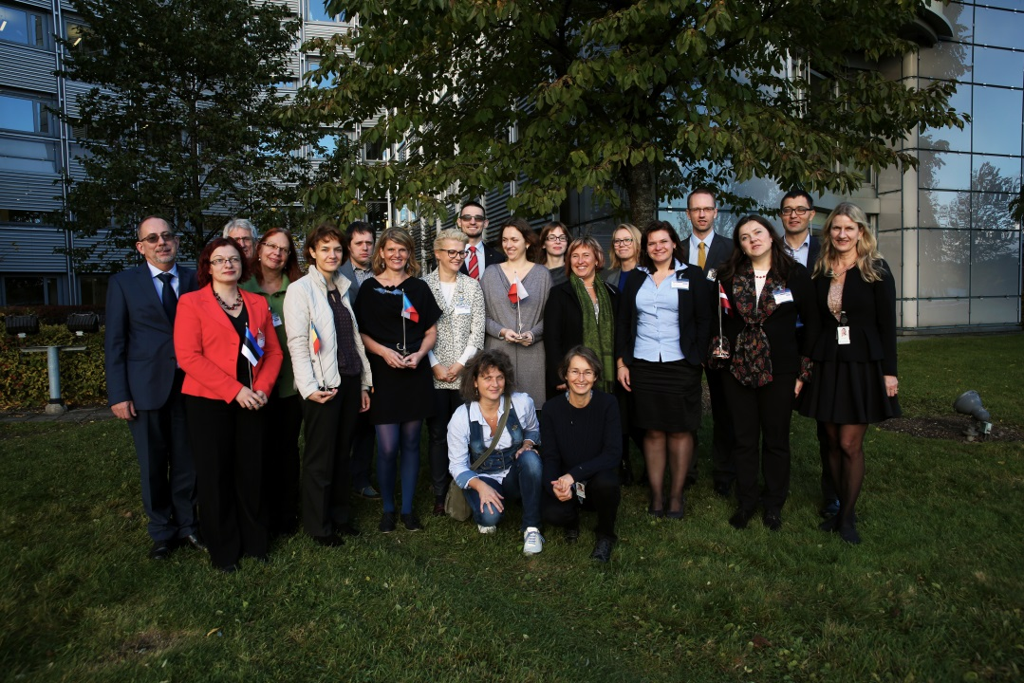
Mutual learning accross the borders

Slide 13
Thank you for your attention!
Birgit Jacobsen bija@rcn.no
Aleksandra W. Haugstad awh@rcn.no

