Slide 1
Project number: EMP181 Targeting glioma stem-like cells with tumor penetrating peptides
Project Promoter: University of Tartu
Project Leader: Tambet Teesalu PhD, Visiting Professor
Project Partner: University of Bergen
Research Group Leader: Rolf Bjerkvig, PhD, Professor

Slide 2
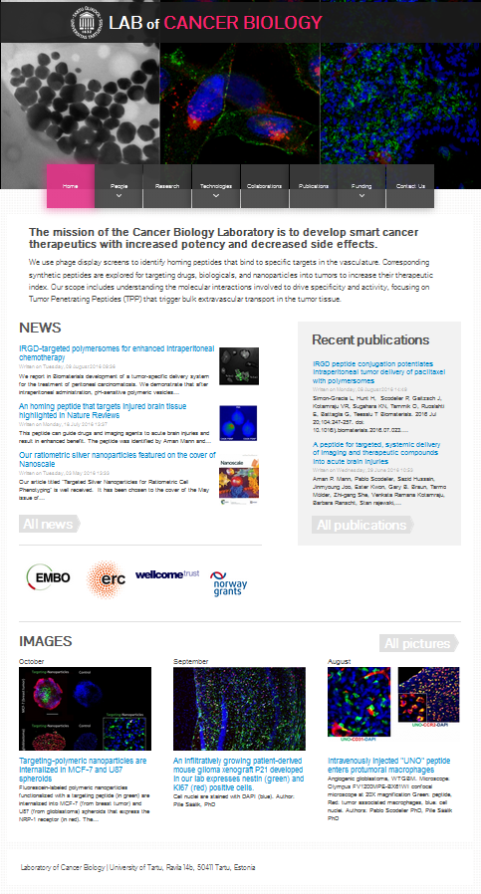
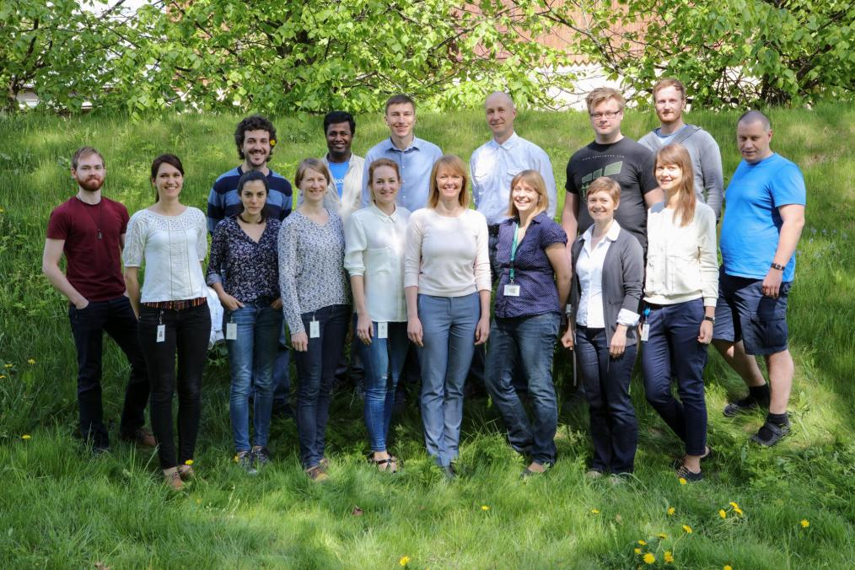
Laboratory of Cancer Biology
The mission of the Cancer Biology Laboratory is to develop smart cancer therapeutics with increased potency and decreased side effects.
We use phage display screens to identify homing peptides that bind to specific targets in the vasculature.
Corresponding synthetic peptides are explored for targeting drugs, biologicals, and nanoparticles into tumors to increase their therapeutic index.

Slide 3
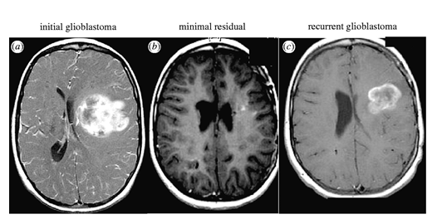
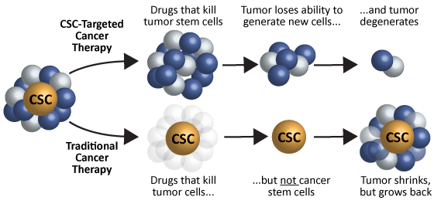
Goal of the EMP181 project: to develop new strategies to target cancer stem-like cells in glioblastoma
Cancer stem-like cells – undifferentiated neoplastic cells
Minor population in solid tumor: 0,1 - a few percent
Self-renewing: infinite proliferative potential
Enhanced resistance to drugs, radiation and cell stress
Associated with tumor progression, metastasis and relapse
Dirks et al. 2008.Philos Trans R Soc Lond B Biol Sci. 363:139-152.
http://www.macrogenics.com/Platforms-cancer_stem_cells_csc.html

Slide 4
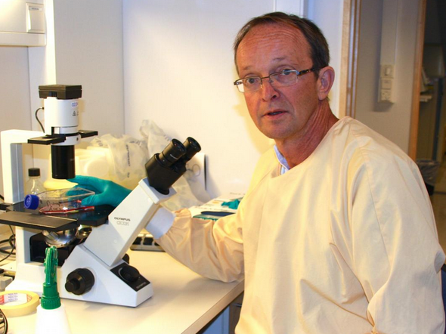
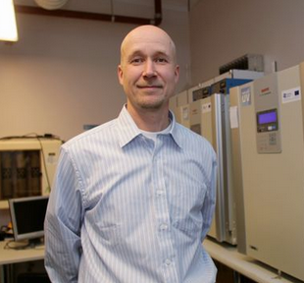
Nor-Est partnership
Prof. Rolf Bjerkvig
University of Bergen
State of the art clinically relevant glioma models
Advanced preclinical imaging systems
Prof. Tambet Teesalu
University of Tartu
Advanced vascular mapping technologies
Preclinical development of precision-guided drugs and nanoparticles

Slide 5
Specific aims of the project
To develop tumor penetrating peptides capable of reaching glioma stem cell–like cells
To characterize the homing mechanism of the peptides.
To use the peptides for delivery of the drugs, imaging agents and theranostic nanoparticles to primary glioma lesions and to infiltrating stem cell-like cells

Slide 6
An example of new homing peptide screens on glioma models from Bergen
Maarja Haugas PhD

Slide 7
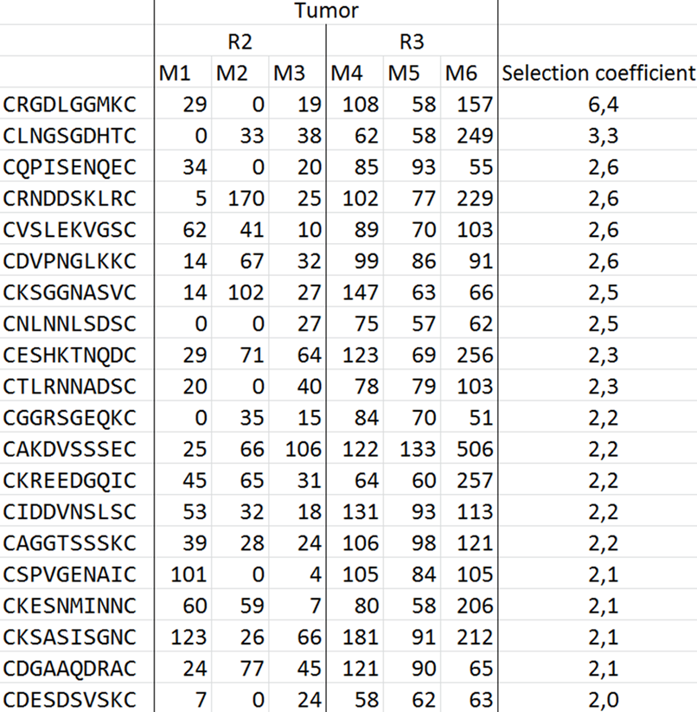
Five candidate peptides selected from CX₈C in vivo biopanning
Peptide 103
Selection criteria – tumor values above 50 in round3
Selection coefficient –
ratio between tumor
and lung in round3
Peptide 106
….
CNSTKAGKKC 100 35 63 544 267 736 1,4
Maarja Haugas PhD

Slide 8
Individual phage binding in vitro
Peptide 103
Peptide 106
P3 stem – human stem-like cell line
VEGFko – mouse GBM
Peptide 103 (first one in the top list) and Peptide 106 (highest counts in Torrent) show best binding properties on GBM cells
Protocol:
3x10⁵ cells
5x10⁸ PFU of phage/reaction
Binding at +4°C for 2 hours
Washing 4 times in DMEM-1%BSA
Cell lysis in LB-1%NP-40
Titer determination
Maarja Haugas PhD

Slide 9
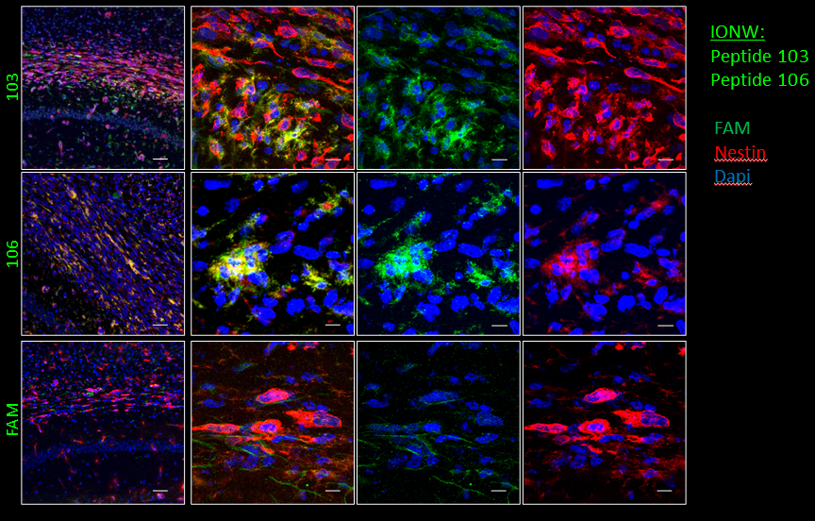
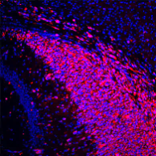
In vivo homing of peptide-IONW in
NCH421k glioma bearing mice
Nestin
Both peptide-IONWs home to NCH421k GBM in vivo
Maarja Haugas PhD

Slide 10
PL1: a dual targeting peptide binding tenascin-c and EDB isoform of fibronectin Prakash Lingasamy MSc

Slide 11
Systemic PL1 nanoparticles home to GBM lesions
Prakash Lingasamy MSc

Slide 12
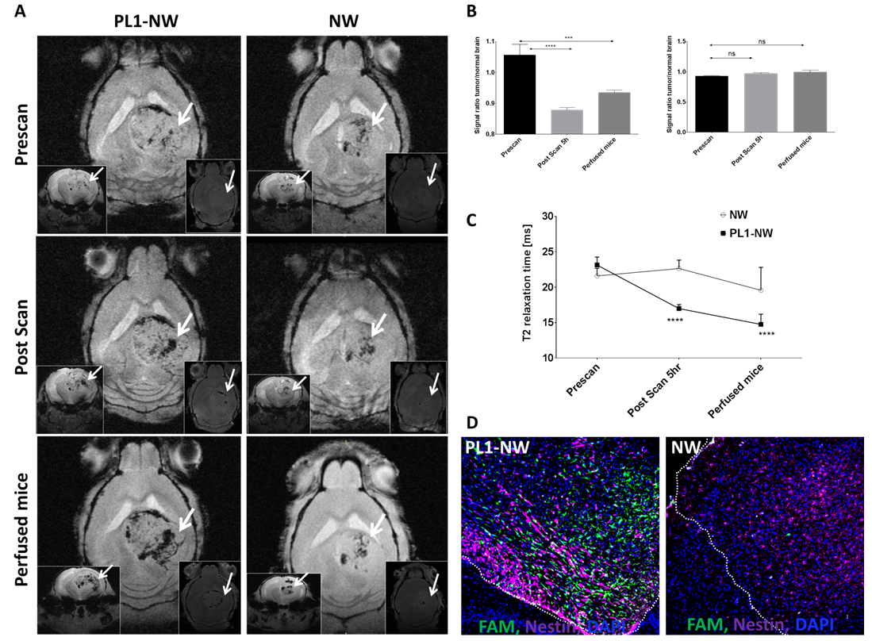
PL1 guided magnetic nanoparticles serve as a MRI probe
Prakash Lingasamy MSc

Slide 13
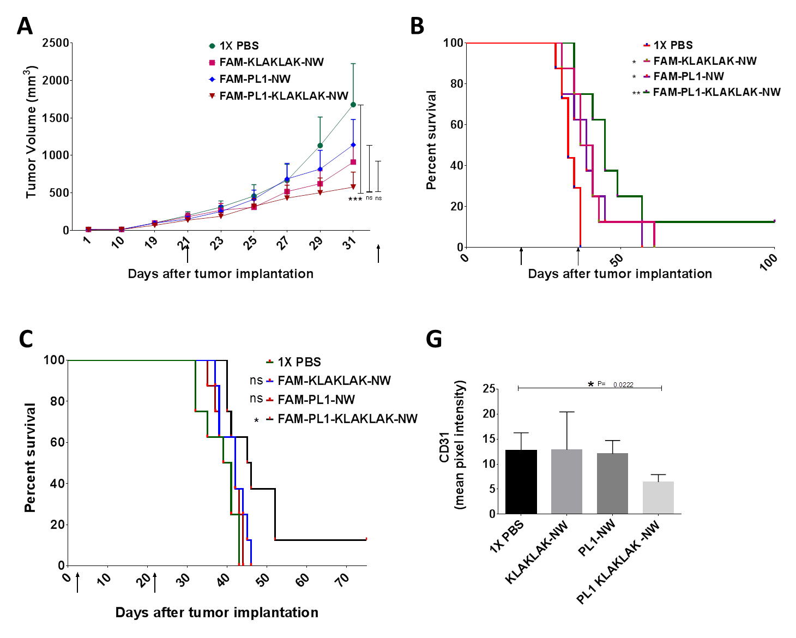
PL-1 guided nanoparticles have antitumor activity
Pille Säälik PhD
Prakash Lingasamy MSc

Slide 14
Outcomes of the EMP181 project
Metrics
5 published reports acknowledging the support of EMP181 grant
4 reports in progress, including one in second stage of revision
Established translationally oriented collaboration between the labs
Introduction of the advanced glioma models in Tartu laboratory
Access to homing peptide ligands and expertise in smart drug/imaging agent design for Bergen laboratory
A number of follow up projects, such as ERC funded GlioGuide project on clinical development of PL1 peptide

Slide 15
Thank you!

