Slide 1
Role of enzyme processivity in degradation of recalcitrant polysaccharides
Professor Morten Sørlie, Norwegian University of Life Sciences
Senior Research Fellow Priit Väljamaë, University of Tartu
21st of September, 2017

Slide 2
Acknowledgements
Research Councils of Norway and Estonia.
We are incredibly grateful for this opportunity
Priit Priit Väljamäe, Silja Kuusk, Mihhail Kurasin, Piret Kuusk (UoT)
Anne Grethe Hamre, Mathilde Holen, Vincent Eijsink (NMBU)
Suvamay Jana, Christina M. Payne (University of Kentucky)
Gregg T. Beckham (NREL)

Slide 3
Chitin and cellulose
Chitin and cellulose comprise an annual production of 1 trillion (1 000 billion) metric tons of organic carbon, the essential building block of life.
Enzymes are need to make products of value besides heat and carbon dioxide in sustainable biorefinery.
Enzymes give a 10 quadrillion or 10 000 trillion rate enhancement of product formation from chitin and cellulose.
We started our collaboration in 2011.
and it still continues…..

Slide 4
Role of enzymes processivity in degradation of recalcitrant polysaccharides
Enzymatic degradation of recalcitrant polysaccharides (chitin and cellulose) occur through the synergistic action of glycoside hydrolases (GHs) with complementary activities.
Processive GHs, both endo- and exo-acting:
closely associate with polymer chains and repeatedly cleave glycosidic linkages without dissociating from the crystalline surface.
are typically the most abundant enzymes in both natural secretomes and industrial cocktails by virtue of their significant hydrolytic potential.
Processive mechanism are believed to be rate-limiting in enzymatic biomass conversion.
Highly challenging to determine processive ability.

Slide 5
Processivity
Processivity (P) refers to the ability of synthesizing, modifying, and degrading enzymes to catalyze multiple successive cycles of reaction with polymeric substrates, such as nucleic acids, proteins, and polysaccharides, without disengaging from the substrates.
P^{intr}$=\frac{k_{cat}}{k_{off}}$(the intrinsic processive ability of the enzyme)
P^{app}$=\frac{N_{cat}}{N_{init}}$ (the apparent processive ability, substrate dependent)
Catalytic efficiency improves enzymatic degradation of recalcitrant polysaccharides.

Slide 6
The history
We at NMBU have 20 years of experience on enzymes active on recalcitrant polysaccharides.
In 2006, we discovered that processive GHs are inherently slow to overcome substrate recalcitrance (Cost and benefits of processivity in enzymatic degradation of recalcitrant polysaccharides, Proc. Nat. Acad. Sci, USA.)
Väljamäe have 10 years of experience in developing methodology for kinetic characterization of GHs
In his seminal work, Väljamäe discovered in 2011 that the length of the obstacle-free path available for a processive run on polysaccharide chain limits the processivity of GHs (later confirmed by a Science paper by Igarashi et al.)

Slide 7
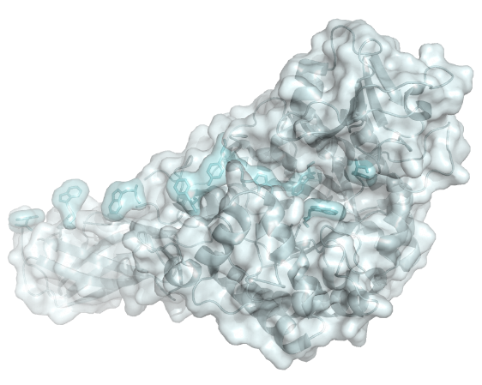
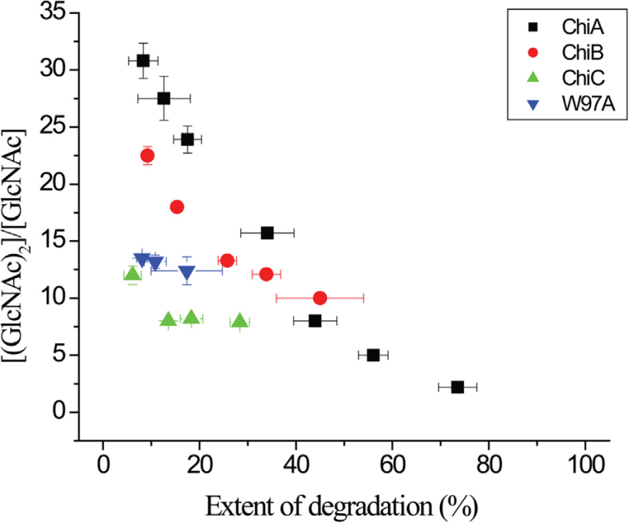
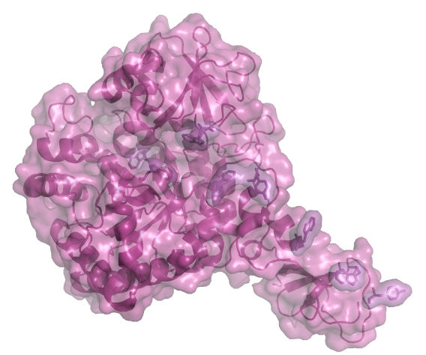
Key findings in the project
We were able to quantify a decrease in processive ability with extent of degradation (reduction in obstacle free path).
ChiA
P^{app}
ChiB
Hamre et al., 2014; FEBS Lett.

Slide 8
Key findings in the project
We confirmed a relationship between binding free energy and processive ability of GHs.
Moreover, GHs active on chitin and cellulose have different rate limiting steps; for chitin active it is complexation with the polymer chain while it is dissociation for the cellulose active.
Kuusk et al., 2015; J. Biol. Chem.
Hamre et al., 2015; J. Phys. Chem. B

Slide 9
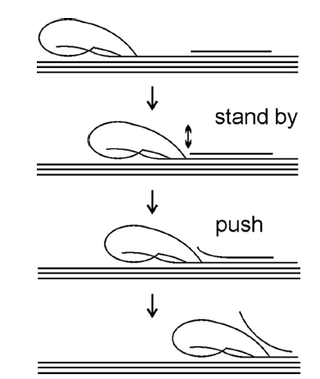
Key findings in the project
A model is proposed whereby strong interactions with polymer in the substrate-binding sites (low off-rates) and strong binding of the product in the product-binding sites (high pushing potential) are required for the removal of obstacles.
Excellent correlation between differences in P^{intr} and binding free energy.
Again confirms obstacle-free path available for a processive run on polysaccharide chain limits the processivity (difference in P^{app} and P^{intr}).
Kurasin et al J Biol Chem 2015

Slide 10
Key findings in the project
The human chitotriosidase (HCHT), a part of our innate immune defense system, is an endo processive GH.
Significantly less processive than i.e. SmChiA, still more efficient in substrate degradation; first observation of such behavior.

Slide 11
Values from the projects
The collaboration between NMBU (enzymes) and University of Tartu (methodology) has greatly increased our understanding of processive GHs.
The projected has resulted in 5 published papers, 1 submitted, and 1 manuscript in preparation; high production.

