Slide 1
The Czech–Norwegian Research Programme Achievements and Experience
Ministry of Education, Youth and Sports
Štěpán OBRTLÍK
Czech Republic

Slide 2
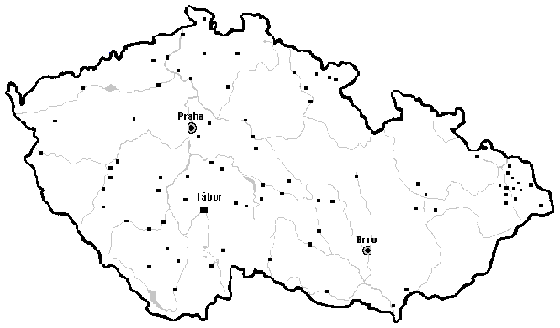
About the programme
Introduction
The Czech-Norwegian Research Programme CZ09
started on 25 February 2013
ends on 31 December 2017
Programme Operator:
Ministry of Education, Youth and Sports
Donor Programme Partner:
Research Council of Norway
Priority areas: Environment, Health and Social Sciences and Humanities
supported 23 bilateral research projects
supported 35 bilateral initiatives

Slide 3
Programme Budget
Budget items | Amount in € | Share % | Allocated %
Management | 1 150 000 | 6,7 | -
Regranting | 15 138 226 | 88,6 | 99
Fund for bilateral relations | 699 084 | 4,1 | 99
Complementary action | 90 781 | 0,6 | -
TOTAL | 17 078 091 | 100 | -

Slide 4
Calls for proposals 2013-2017
Summary on completed Calls for proposals
Regranting – Major Call - From 29 November 2013 to 3 February 2014
389 proposals submitted (6 formally dismissed)
19 selected research projects (later 4 from the reserve list)
Success rate: 4,9%
2. Fund for bilateral relations - From 18 July 2016 to 20 January 2017
42 proposals submitted (7 formally dismissed)
35 selected initiatives
Success rate: 86%

Slide 5
Objectives and outcomes of the programme
Target groups and outcomes
Targed groups
Support of young researchers (involvement of Ph.D. students and postdocs in projects) and their mobility: 317 Ph.D.s + 222 postdocs
Involvement of researchers who have returned after maternity leave: 13
Number of international cooperations: 57 (research projects and initiatives)
Of which number of supported research projects: 23
Internationally refereed (joint scientific) publications: 232
Main objective of the programme
Increased research cooperation between Norway and the Beneficiary States

Slide 6
Fund for bilateral relations
35 non-research initiatives supported from the Fund
Total allocation „Measure B“ € 678,981 (used 77,80%)
Activities enhancing bilateral cooperation in research:
Knowledge exchange, joint project proposals, events
The most often occured Czech promoters
Masaryk University, Brno – 9 times
Brno University of Technology, Brno – 3 times
The most often occured Norwegian partners
University of Oslo – 6 times
The Arctic University of Norway, Tromsø – 4 times
7F16014 PROMOB (foto: M. Slámová)

Slide 7
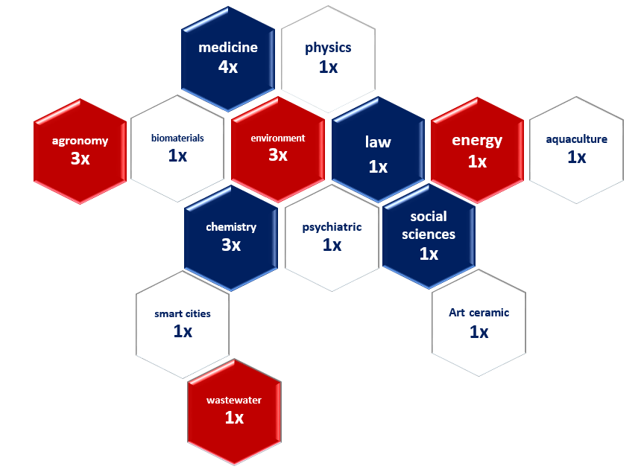
Fund for bilateral relations - statistics
Major type of initiatives
Study and work trips – 90 times
Events – 53 times
Publicity – 27 times
Joint project proposal for Horizon 2020 – 5 times
Target groups actually supported
462 male / 455 female
Senior researches – 214 persons
Ph.D. students – 205 persons
Postdocs – 132 persons
Returned after parental – 13 female
Major fields of bilateral cooperation
Medicine – 4 times
The environment – 3 times
Chemistry – 3 times

Slide 8
Experience and lessons learnt at glance
Programme implementation 2013-2017
Aspects/factors influancing the programme implementation
Communication (distant, in third language and publicity/results dissemination)
Moral and ethical issues (attitudes, trust, deals, values)
Legal issues (project contracts, partnership agreeements)
Financial issues (target approach vs. overspending, modifications, overheads)
Administrative issues (practice, jobs specialization, exchange rate, reporting)
Economical and cultural differences (budgeting costs, work regimes)

Slide 9
Final Conference
Programme implementation 2013-2017
Final Czech-Norwegian Research Conference – Prague 2017
Achievements, research projects, experience
In Prague on 7 November 2017
For details and registration, please go to the link:
http://www.msmt.cz/vyzkum-a-vyvoj-2/final-conference-of-czech-norwegian-research-programme-cz09
Notes:
Time – very precious value
Freedom vs. bureaucracy
Applying rules from different research programmes by project participants
Lack of legal awareness and support at entities – such as not following project contracts
Own/or Norwegian/or public funds
Underestimation of administration background by entities/principal investigators
Low personnel capacities at stakeholders
Communication – crucial (in third language)
Publicity (of results) of the projects and Norway Grants (financial mechanisms)
Meeting two different „administrative cultures“
Late payment transactions, yearly and vague timesheets

Slide 10
THANK YOU FOR YOUR ATTENTION.
Please find out more at the programme web site:
http://www.msmt.cz/vyzkum-a-vyvoj-2/czech-norwegian-research-programme
Ministry of Education, Youth and Sports
Department of Strategic programs and projects
Karmelitska 5
118 12 Prague 1

