Slide 1



The importance of international research cooperation:
Project partners views on Norwegian-Estonian research cooperation
Clive Bramham
Department of Biomedicine &
KG Jebsen Centre for Research on Neuropsychiatric Disorders
The University of Bergen, Norway

Slide 2
Activity-dependent regulation of BDNF and Arc:
master genes in synaptic plasticty
Clive Bramham
Department of Biomedicine &
KG Jebsen Centre for Research on Neuropsychiatric Disorders
The University of Bergen, Norway
Norwegian-Estonian Research Cooperation
Project number: EMP128
Research Project Leader: Tonis Timmusk, Tallinn University of Technology
Research Group Leader: Clive Bramham

Slide 3
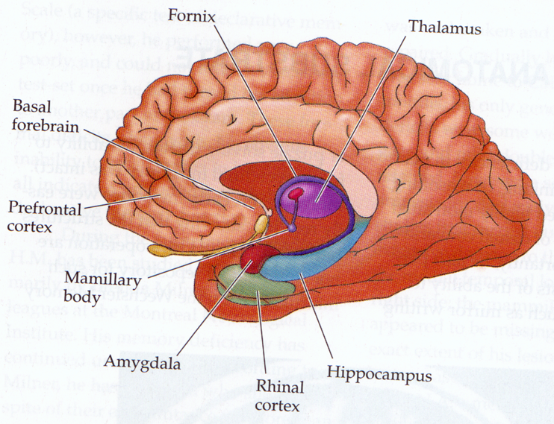
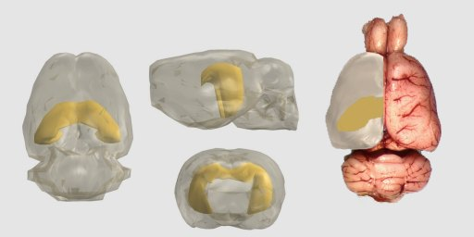

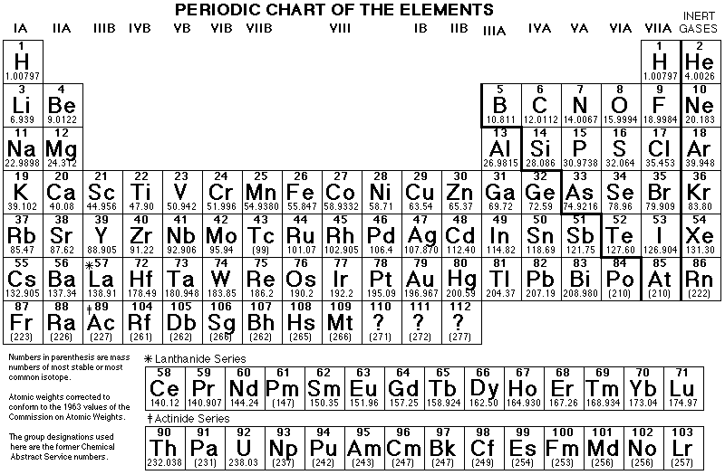

Mechanisms on brain information storage
Periodic Table of the Elements
Places and events
Facts
Cognitive dysfunction

Slide 4
Importance of international research cooperation (funding!)
Multidisciplinary and big team efforts are more and more required.
Technologies are highly-specialized and costly.
Few institutions have the necessary expertise and tools in one place.
Synergy effects are readily obtained.
Promotes the flow of information – being «in the know».
Spawns new activities and networks
It’s all about People, people, people!

Slide 5
Pillars of success
Convergent research interest
Complementary expertise and technology
Bilateral exchanges at different levels

Slide 6
Convergent research interest
Both PIs are neuobiologists interested in the regulation and function of the immediate early genes BDNF and Arc.
 | Timmusk lab | Bramham lab
Genes | BDNF | Arc
Biological Levels | Neuronal activity | Synaptic plasticity

Slide 7
Complementary expertise and technology
 | Timmusk lab | Bramham lab
Levels of analysis | DNA/Transcription | mRNA/Protein
Model system | cells | animals
Treatments | Chemical | Electrical
Expertise | Molecular biology | Electrophysiology & biochemistry

Slide 8

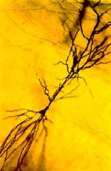
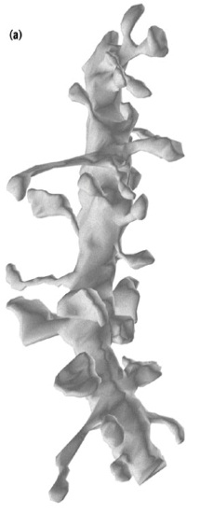
Neuronal Plasticity:
experience-dependent modification of synaptic strength
adaptive brain functions including memory storage
Neuron
Dendrite
Synapse
Notes:
Nervous system allows us to interact with the environment, extract information about lrelevant information that is used to spape behavior. .
Evident to the first anatomist to see them that synapse could be the substrate for this speciifity.
Spine as compartment sufficiently autonomus to provide speciifcity for information storage.
Synaptic plastiicty as a natural focus point in considering adaptic responses of neural circuits in a variety of functions, cinlding liearning nd memory.
Rich variety of types. LTP, LTD, depotentiation, metaplascitiy.
The formation of long-term chnage requires actiivity-depedent changes in gene expression. What are the genes involve whose actiivty-dependent expression is necssary for and perhaps causes the change in synaptic strength.
This talk is dvidein to two parts The firat part of this talk I will present evidence suggesting that LTP conssolidation critically requires the actiivty-induced, dendritically transported mRNA species, Arc.
In the scond part of the talk about dendritic protein synthesis and how biochemical control of local protein synthesis shapes the consolidation process.

Slide 9
BDNF - Brain-derived neurotrophic factor
Arc - Activity-regulated cytoskeleton-associated protein
BDNF
Arc
Brain plasticity
Memory & Alzheimer’s Disease

Slide 10
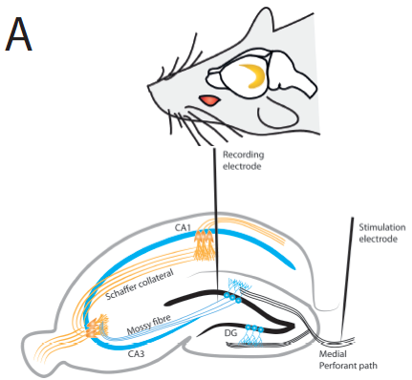
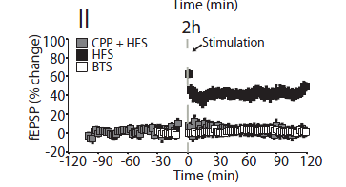
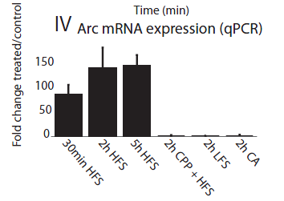
Long-term potentiation: a model of synaptic plasticity

Slide 11

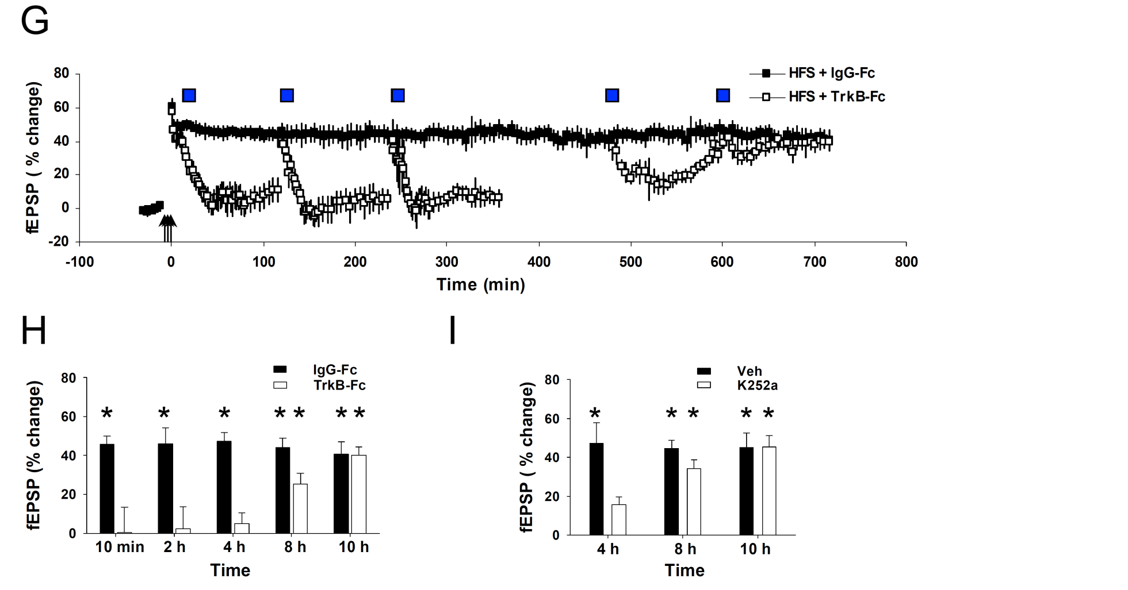
LTP consolidation requires a time-window
of sustained BDNF-TrkB signaling
Debabrata
Panja
*
*
*
*
*
Panja et al., Cell Reports, 2014
Time

Slide 12
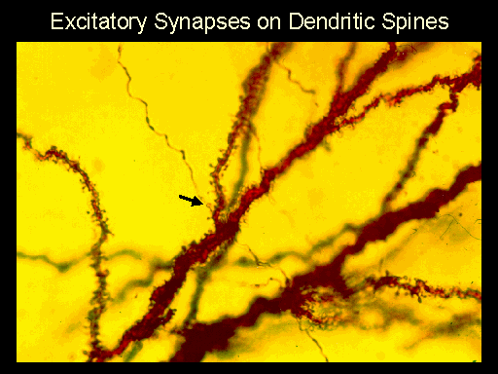
How can gene expression modify
specific subsets of activated synapses?
Dendritic protein synthesis

Slide 13
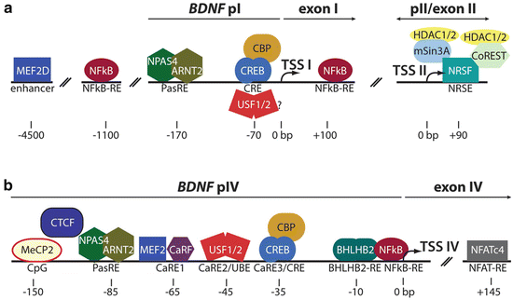
Regulation of BDNF transcription

Slide 14
BDNF transcription reporter assays

Slide 15
Bilateral exchange (Cross-fertalization)
at different levels
PIs gives seminar at the partner institution
Secondments: postdoc, PhD, technician
Joint workshops or retreats

Slide 16
Comment
Funding:
Excellent for consumables on the Norwegian side,
though not enough to employ anyone.
This means that manpower contribution from the Norwegian lab must be drawn from other (related) projects.
This lessens the bilaterality.
Proposal: Norwegian funding in (biomedical) projects should allow for 1 position (postdoc) and running expenses.

Slide 17

Continue funding ground-breaking basic research
The ovum
Telescope with corrective lens
Universe>galaxy
Memory consists of systems
Dark matter
Earliest sexual act
Original African migration
Stress in plants
Next big discovery?
Thanks to the Norwegian-Estonian
Research Cooperation Programme!

