Slide 1

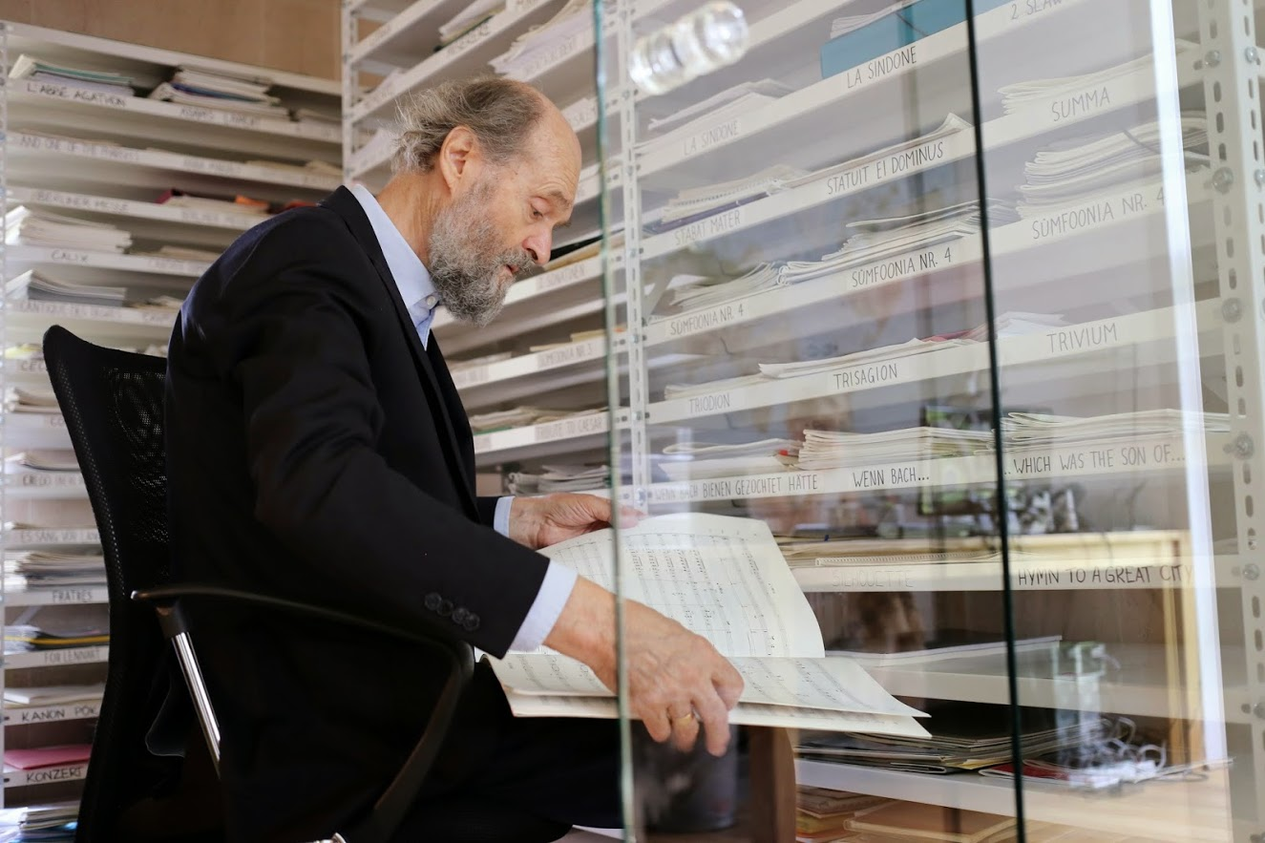
Arvo Pärt and Arvo Pärt Centre
in Laulasmaa, Estonia
September 21, 2017

Slide 2
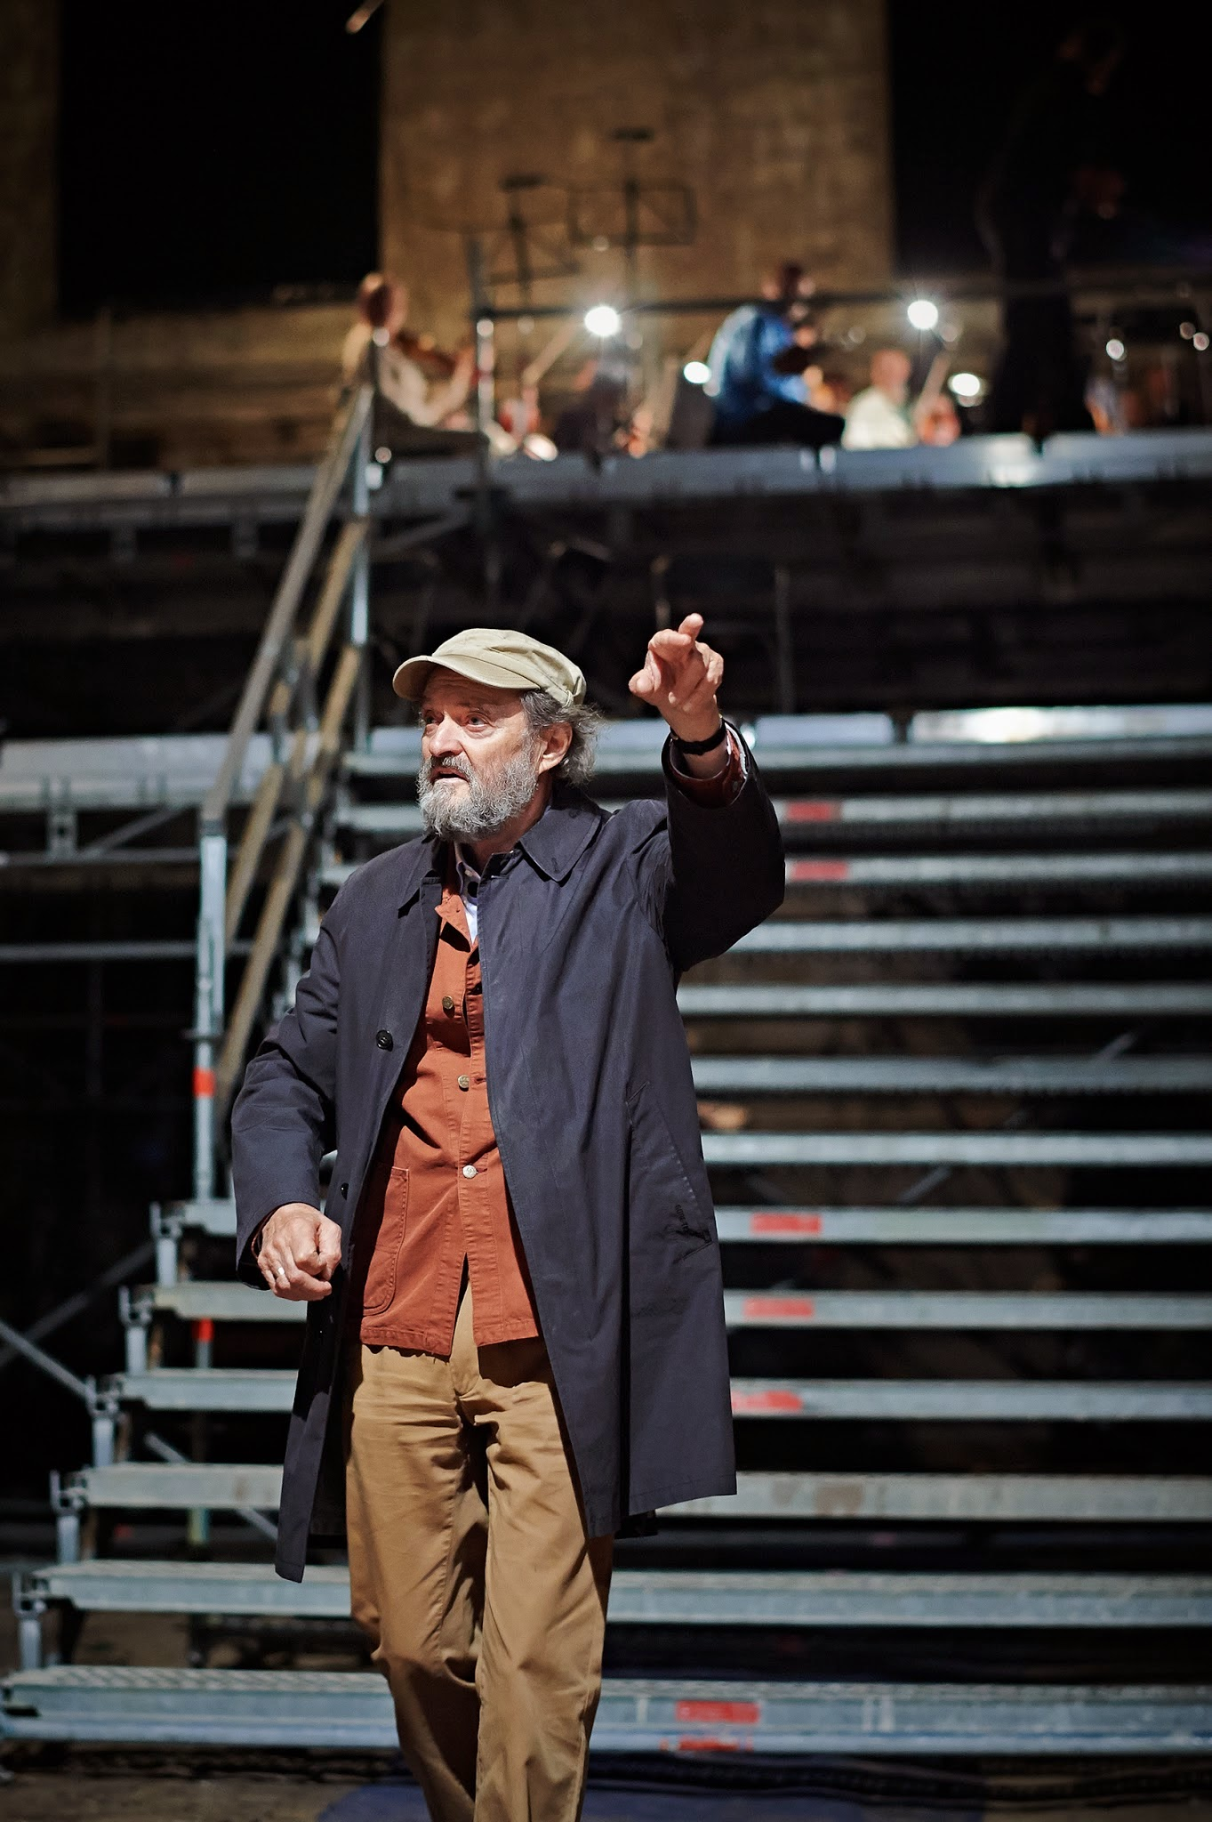
Arvo Pärt (born in 1935)
A composer who created a new paradigm of 20th century music with his unique tintinnabuli-technique and highly original approach to music essentially sprouting from religious thought.
Early period (1958–1968)
Modernist: used dodecaphonic, sonoristic, collage-styles
Years of crisis (1968–1976) and the birth of tintinnabuli
„Für Alina”, “Cantus in Memory of Benjamin Britten”, “Fratres”, “Tabula rasa”, “Spiegel im Spiegel”
Emigration (1980 – 2010)
“Passio”, “Stabat Mater”, “Te Deum”, “Miserere”, “Berliner Messe”, “Litany”, “Kanon pokajanen”, etc.
Permanently back in Estonia (since 2010)
“Adam’s Lament”, Symphony No. 4, „Vater Unser“ etc.
© Arvo Pärt Centre

Slide 3
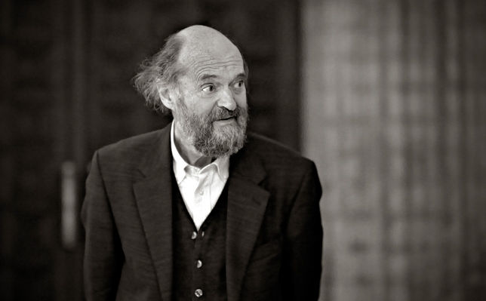
Arvo Pärt is the most performed contemporary composer in the world
„The purity and the intensity, the drama of the quiet in his music has been evident from the first time I heard his work.”
– Manfred Eicher, producer
“World’s most performed living composer”
– bachtrack.com
„One of the most distinctive voices in contemporary music, and also among the most performed and recorded.”
– bbc.co.uk
„From avant-garde density to luminous simplicity, Pärt has been a constantly fascinating musical journey.“
– bbc.co.uk
„His music fulfills a deep human need that has nothing to do with fashion.“
– Steve Reich, composer
„His music has been performed by major orchestras, from the Los Angeles Philharmonic to the National Symphony Orchestra, but it is also beloved of musicians from Björk to R.E.M. to Radiohead.“
– Washington Post
„I love his music, and I love the fact that he is such a brave, talented man ... He's completely out of step with the zeitgeist and yet he's enormously popular, which is so inspiring.“
– Steve Reich, composer
© klassikakzente.de

Slide 4
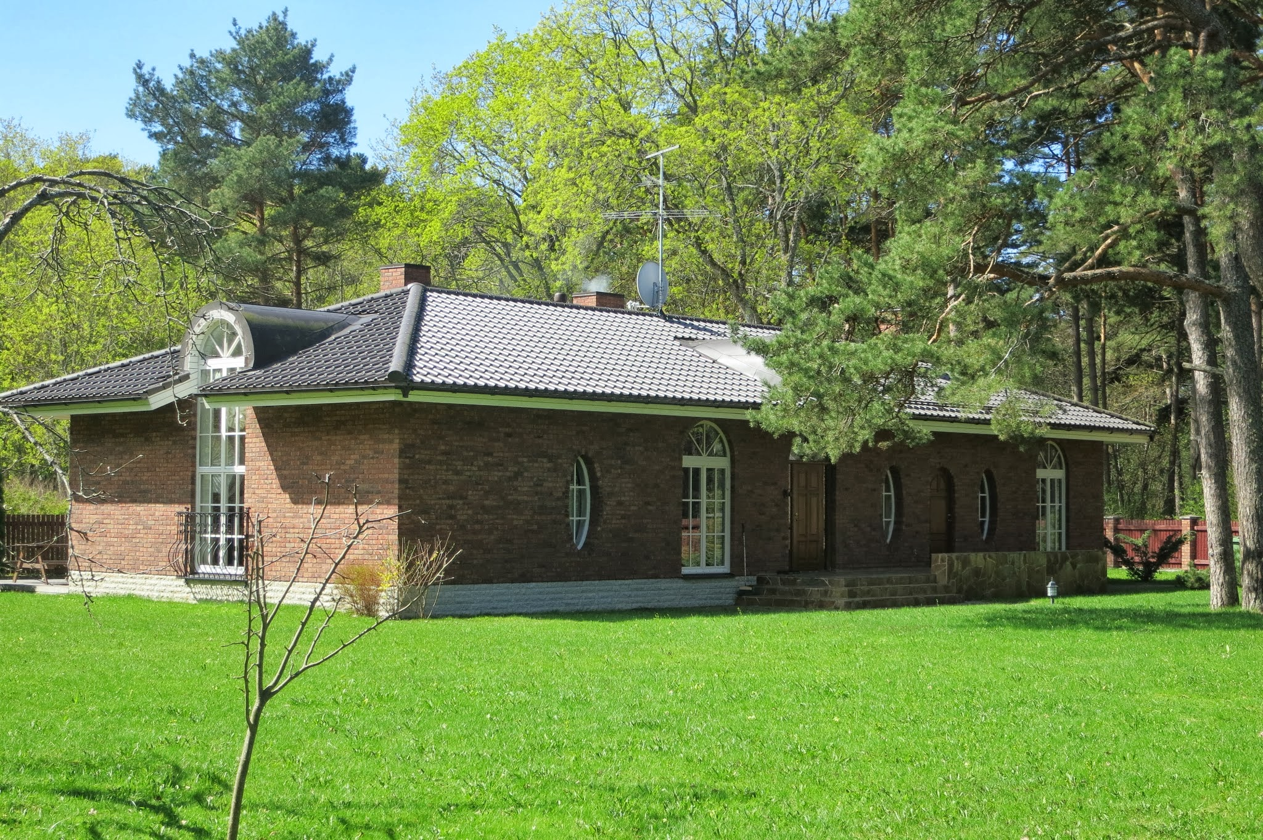
Arvo Pärt Centre
The Arvo Pärt Centre (APC) was founded in 2010 by Arvo Pärt and his family with the aim of creating opportunities for preserving and researching the creative heritage of the composer in Estonia and in the context of the Estonian language.
The APC is situated in Laulasmaa, 35 km from Tallinn, on a peninsula with natural surroundings – within a pine forest near the sea.
Its primary function is and will be providing a research and learning environment with the archive at its heart.
The core of the APC is the archive, which brings together the entire creative heritage of the composer and realted information and documents, both in physical and digital form.
© Arvo Pärt Centre

Slide 5
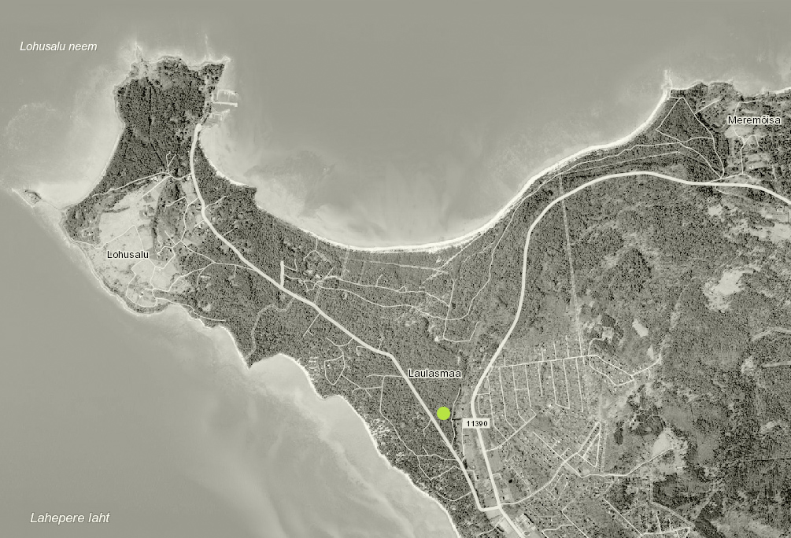
The objectives of Arvo Pärt Centre is to be:
Memory institution
Authentic information centre
Carrier of an intellectual message; to elaborate / explain / reflect upon the message of Arvo Pärt and his music
An environment that in every detail corresponds to the character of the music of Arvo Pärt
International meeting-place that brings artists and people inspired by the heritage of Arvo Pärt together
Creative and playful, rather than a deeply serious sanctuary
© Arvo Pärt Centre

Slide 6
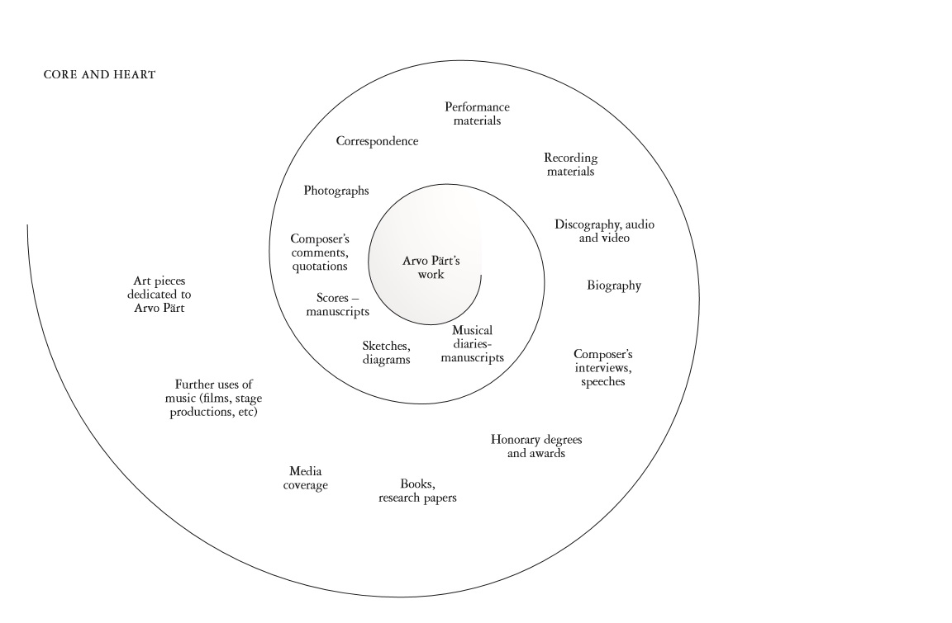
What the Arvo Pärt archive contains?
© Arvo Pärt Centre

Slide 7
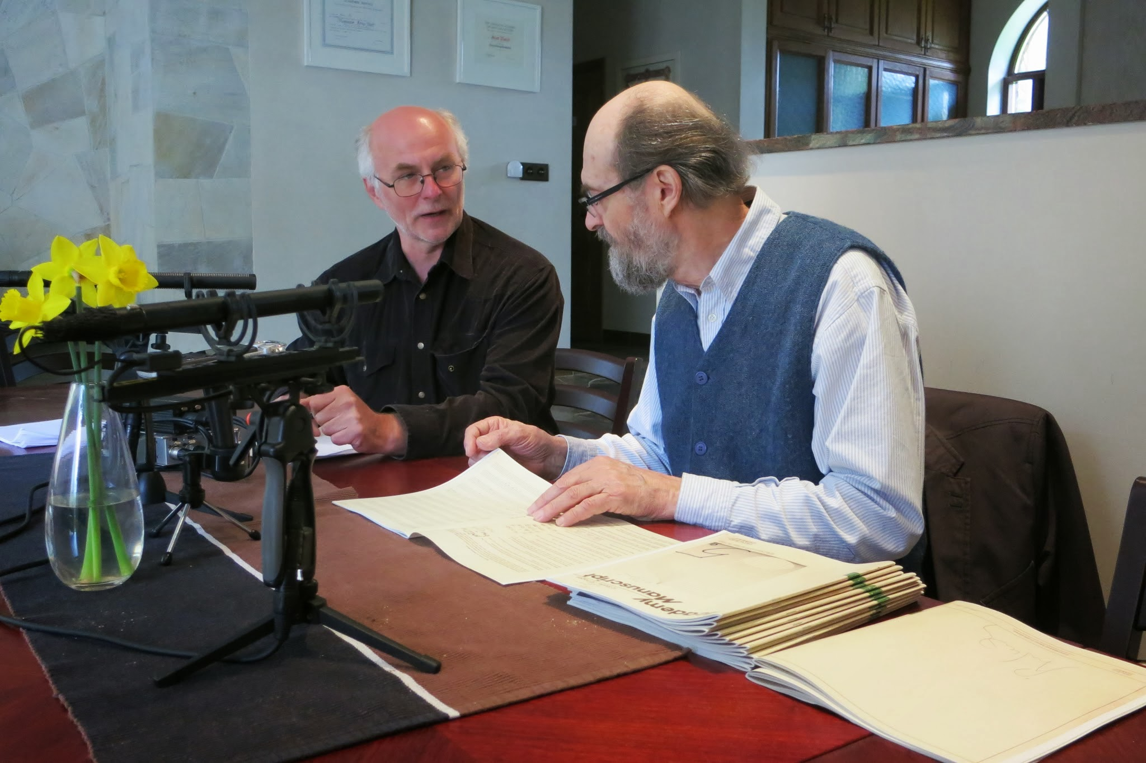
What makes the work of Arvo Pärt archive unique?
Composer participates in building up the archieve:
  description of the creative process of the works
  commenting of musical diaries
Arvo Pärt, who is actively composing, is still using much of the archieval material also in its current works
  composing new pieces
  correcting and arranging his earlier work
Practically every day brings in new material:
  photos
  performances, reviews etc.
© Arvo Pärt Centre

Slide 8
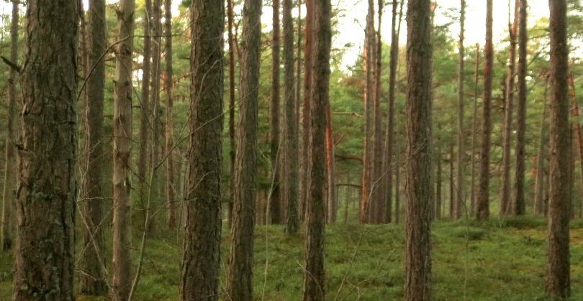
Arvo Pärt Centre new building – Why new building and why at Laulasmaa?
2010 Arvo Pärt decided to live at Laulasmaa
Two important teachers of Arvo Pärt (Ille Martin, Heino Eller) spent summers at Laulasmaa
Important place for Estonian music: Heliküla, etc.
Nature and surrounding gives a visitor a possibility to understand and perceive the essence of Arvo Pärt creation and life.
The APC invites visitors to involve themselves deeper and not just pass by. The journey to Laulasmaa is a prepartion for a visit.
Not everything should be in Tallinn, Berlin or New York
It currently operates in two private buildings that were initially not built for the archive.
© Arvo Pärt Centre

Slide 9
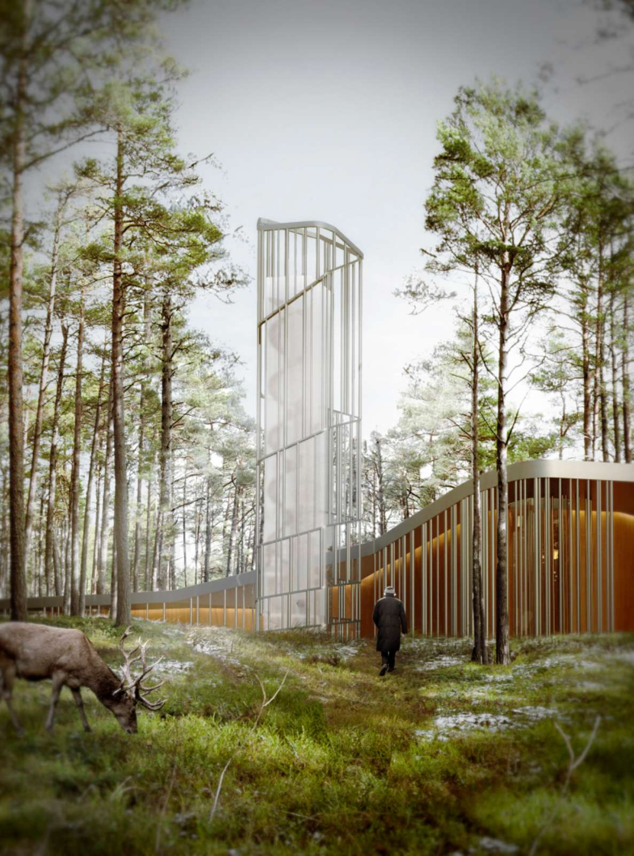
New APC Timeline
International 2-stage
design contest
2013
planning activities, funding and operating business
1
2014
2
Design development
2015
Detailed planning completion and bidding
3
2016
4
construction and
fitting out interior
2017
Work completion and
opening of the new building,
Estonia celebrates its 100th anniversary
5
2018
6
TOWER Render of the New APC ©
Notes:
Title?

Slide 10
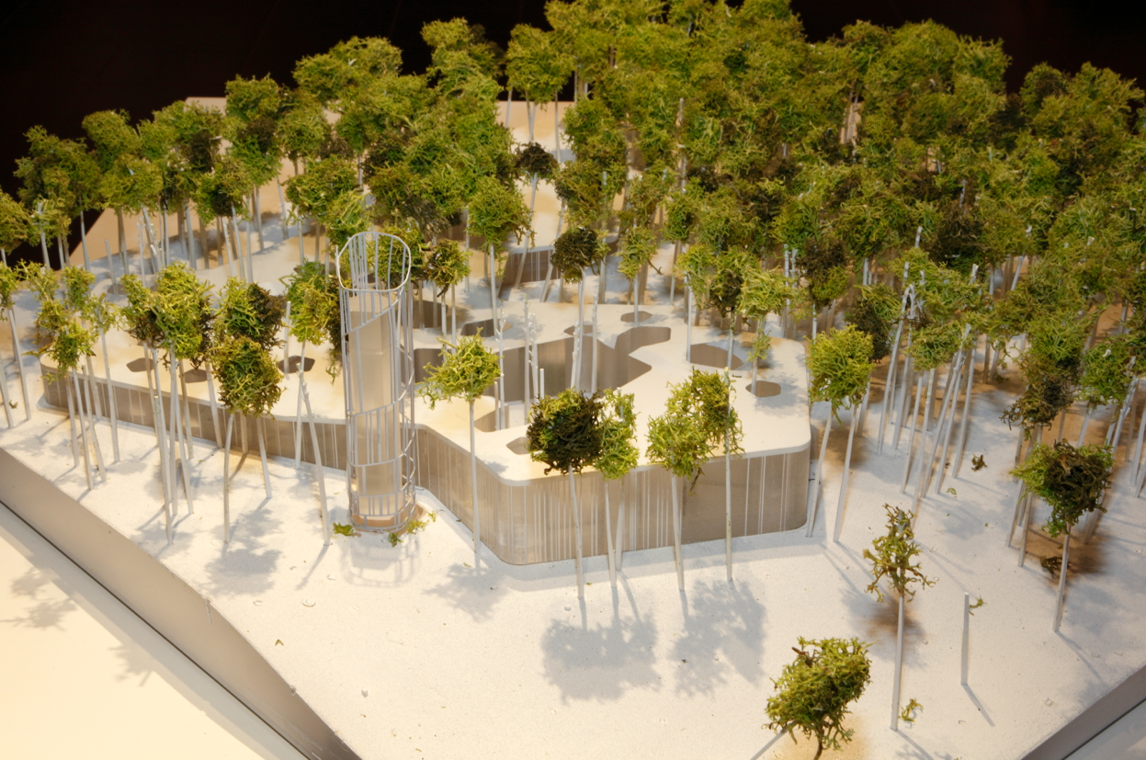
“TABULA” won the design contest for the new Arvo Pärt Centre in June 2014
In June 2014, the president of Estonia Toomas Hendrik Ilves announced the winners of the contest for the architectural design of the Arvo Pärt Centre building at the Museum of Estonian Architecture in Tallinn.
Fuensanta Nieto and Enrique Sobejano from Nieto Sobejano Arquitectos SLP, Spain, titled TABULA won the design contest.
Michael Pärt, chairman of the Jury and Arvo Pärt´s son, about the winning design:
”‘Tabula’ creates a harmonious and flexible environment for Arvo Pärt´s music. What deserves to be singled out in particular about this contest entry is its spatial arrangement and thoroughly considered thematic lighting.”
© Nieto Sobejano Arquitectos

Slide 11
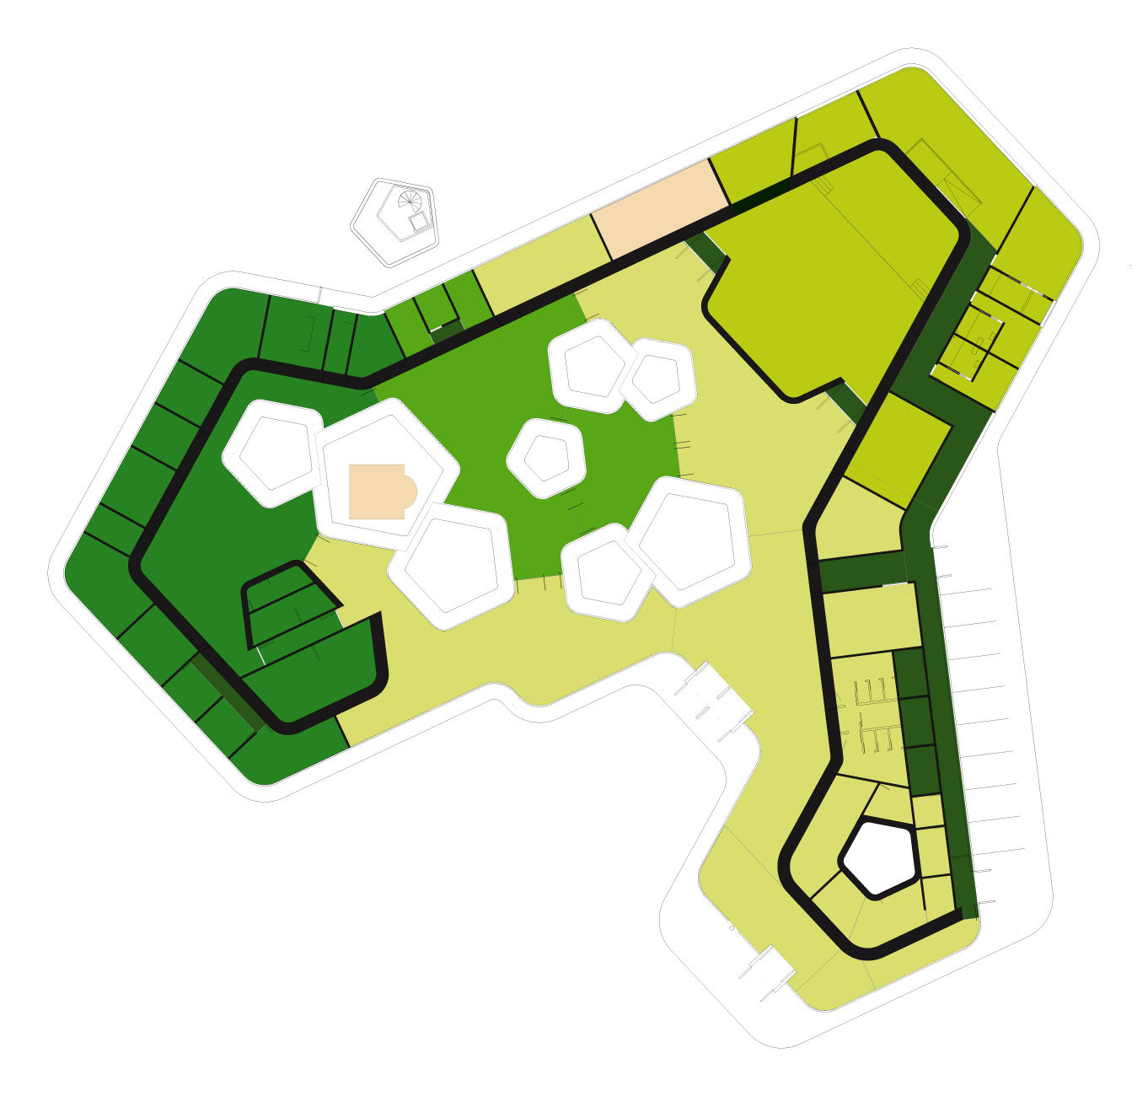
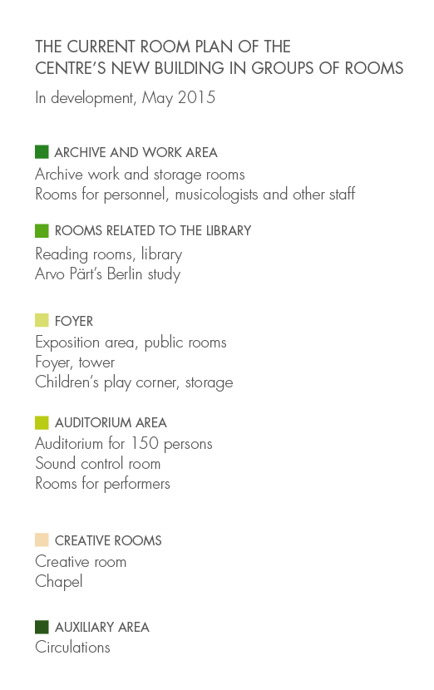

Slide 12
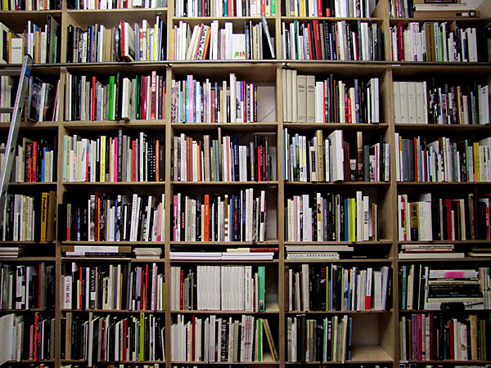

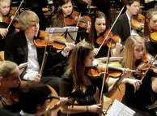
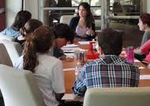
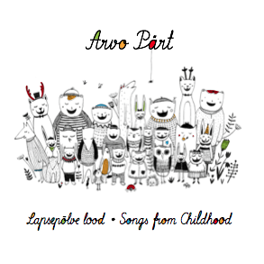
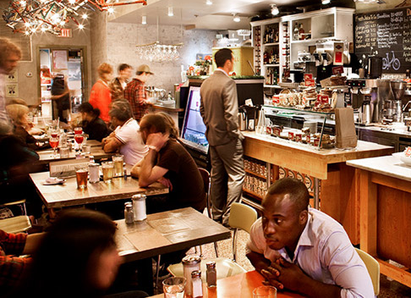
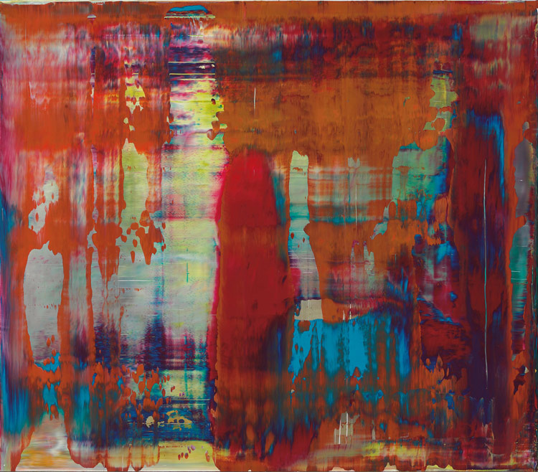
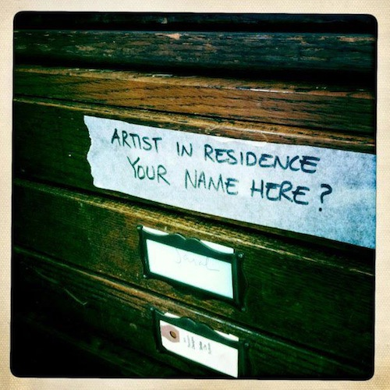
The range of activities of the new Arvo Pärt Centre
Archive & Library
storage, preservation, research of the legacy
Arvo Pärt info system (APIS)
Education
school trip weeks
school excursions
summer courses
Events
concerts and concert/film weekends
cross-disciplinary programming
Activities
NEW APC
Science & Scholarly
conferences
lectures
master-classes
Publications
books
CDs and DVDs
On-line publications
Exhibitions
permanent exposition
temporary exhibitions
Artists in residence
studio for different art fields
recording possibilities

Slide 13
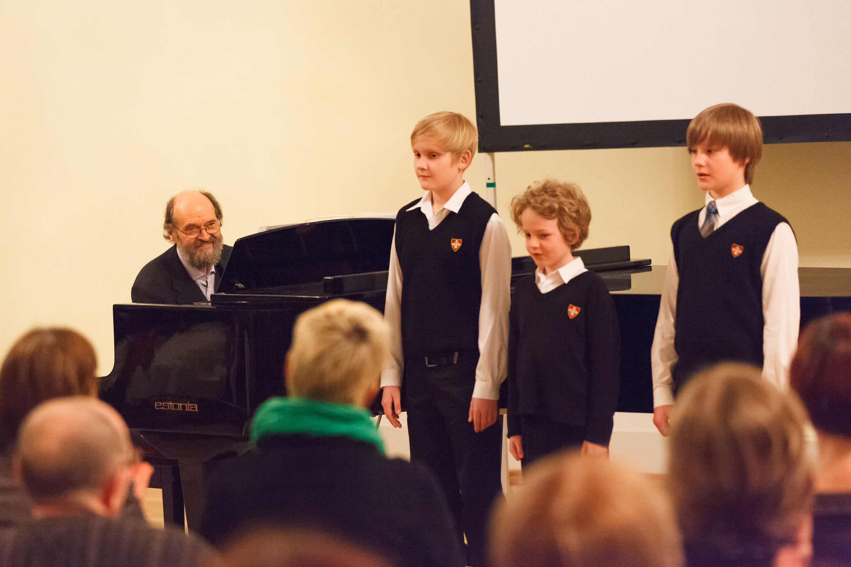
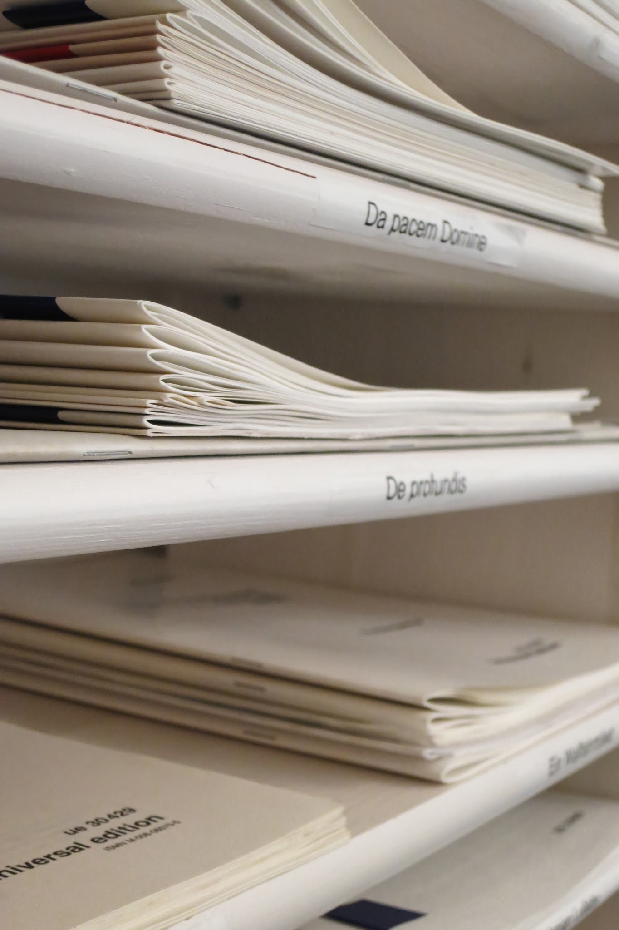
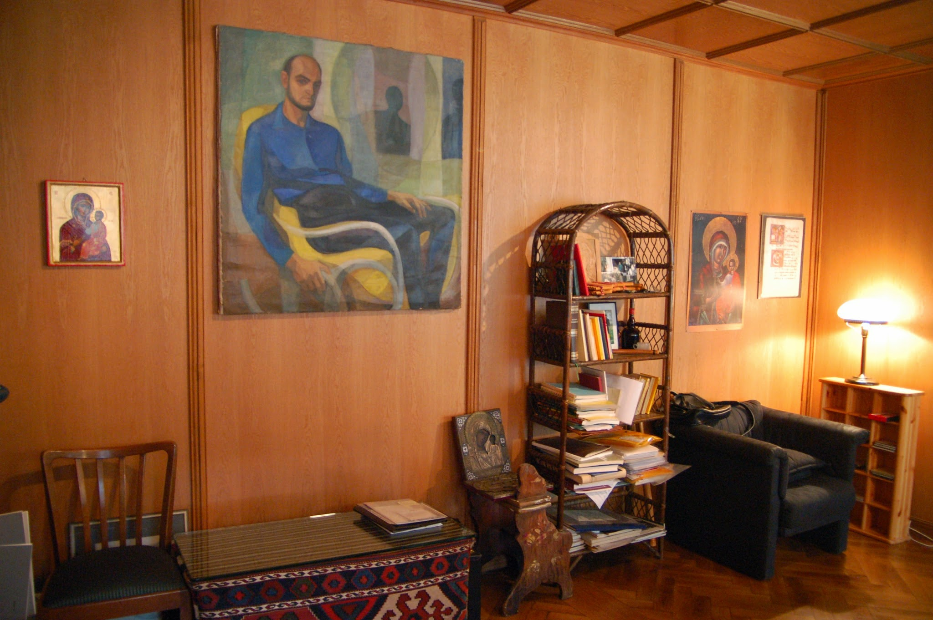
New public components thanks to the new house
Education:
school excursions with different educational programs
summer courses for children together with summer camps in Laulasmaa, etc.
Science & Scholarly:
serving international scholars
conferences, lectures, master-classes
international co-operation with different institutions (Arnold Schönberg Center, Britten-Pears Foundation, St.Vladimir Orthodox Theological Seminary, etc)
Exhibitions:
permanent exposition
temporary exhibitions
Every schoolchild in Estonia will visit APC at least once during his schoolyears!
Authentic information centre
Perfect environment and meeting place for people interested in AP’s heritage
One of the hot-spots in Estonia to visit
Adds one extra day for international tourists

Slide 14
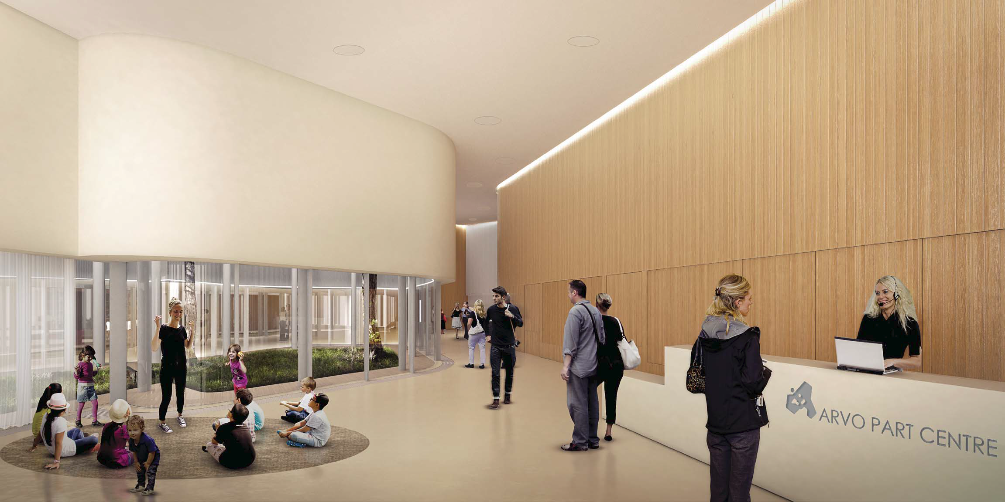
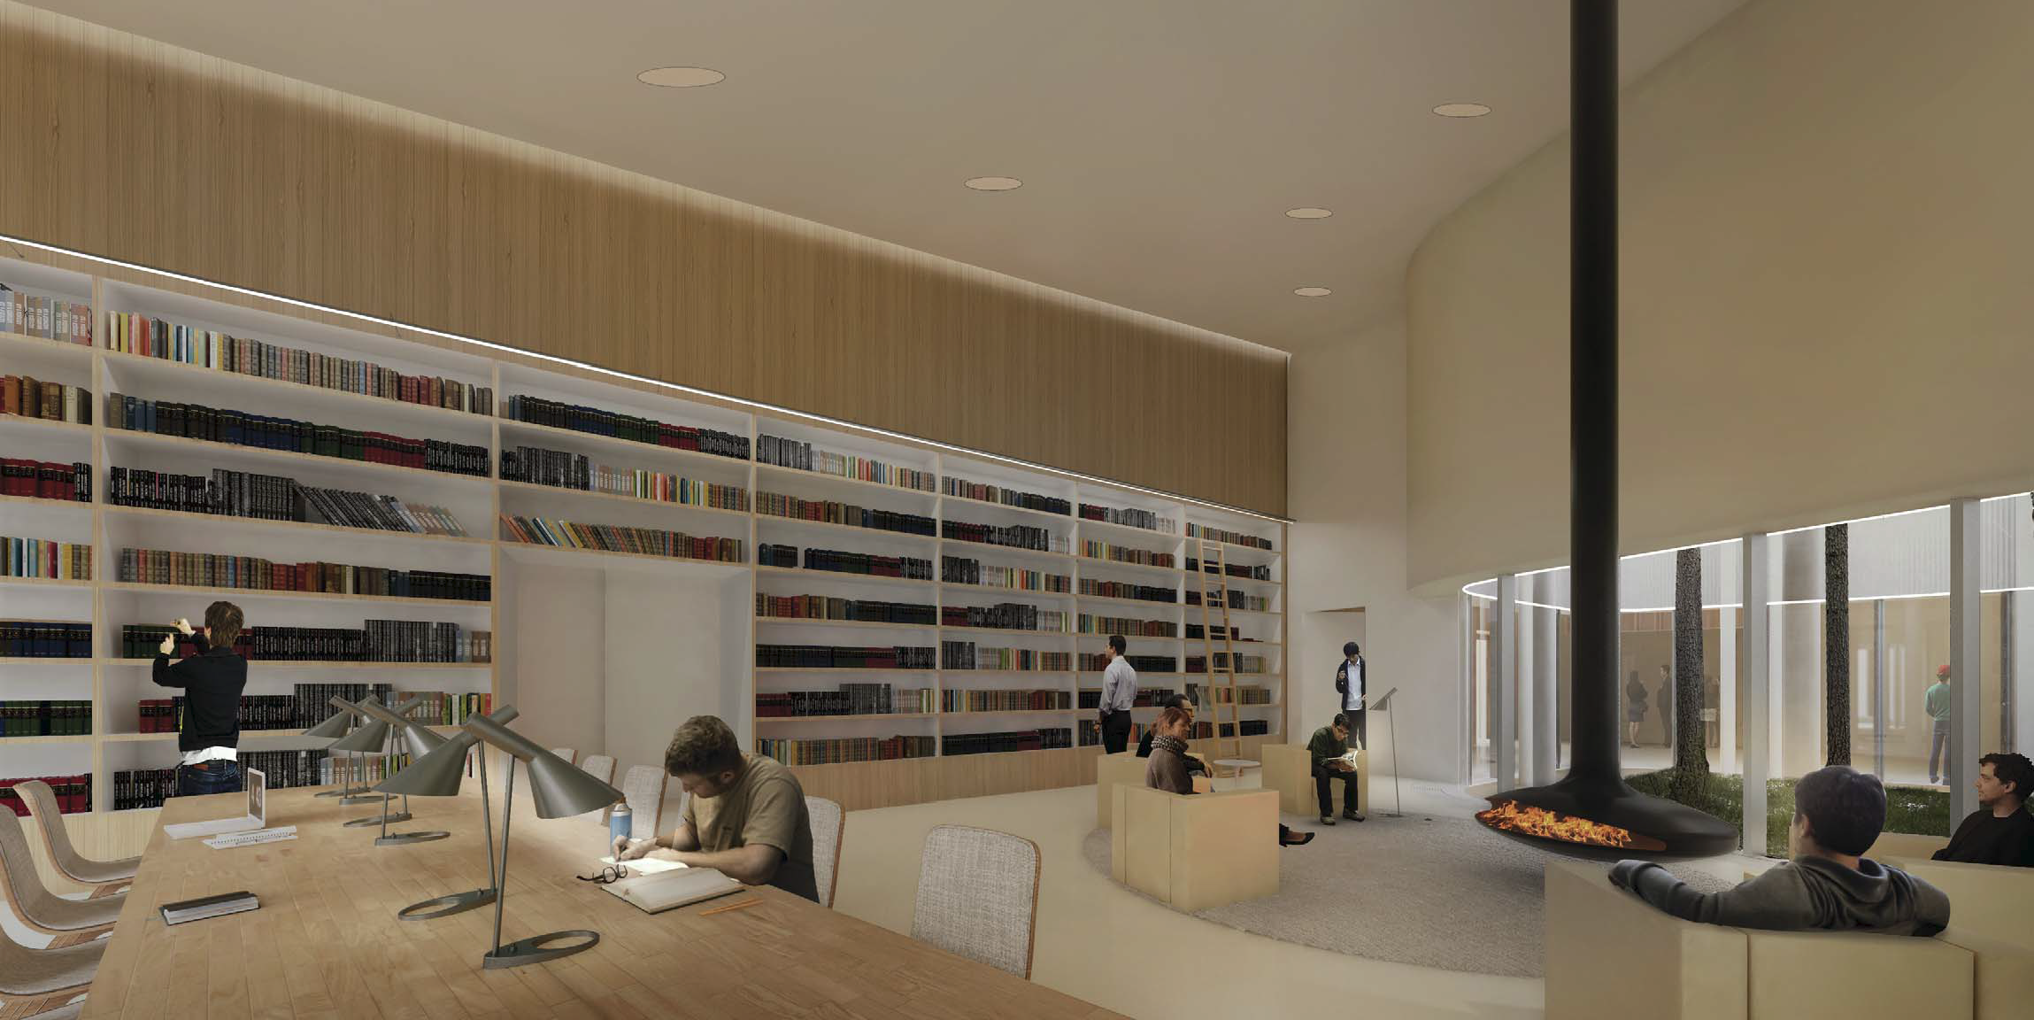
TABULA
Reception
© Nieto Sobejano Arquitectos
Library

Slide 15
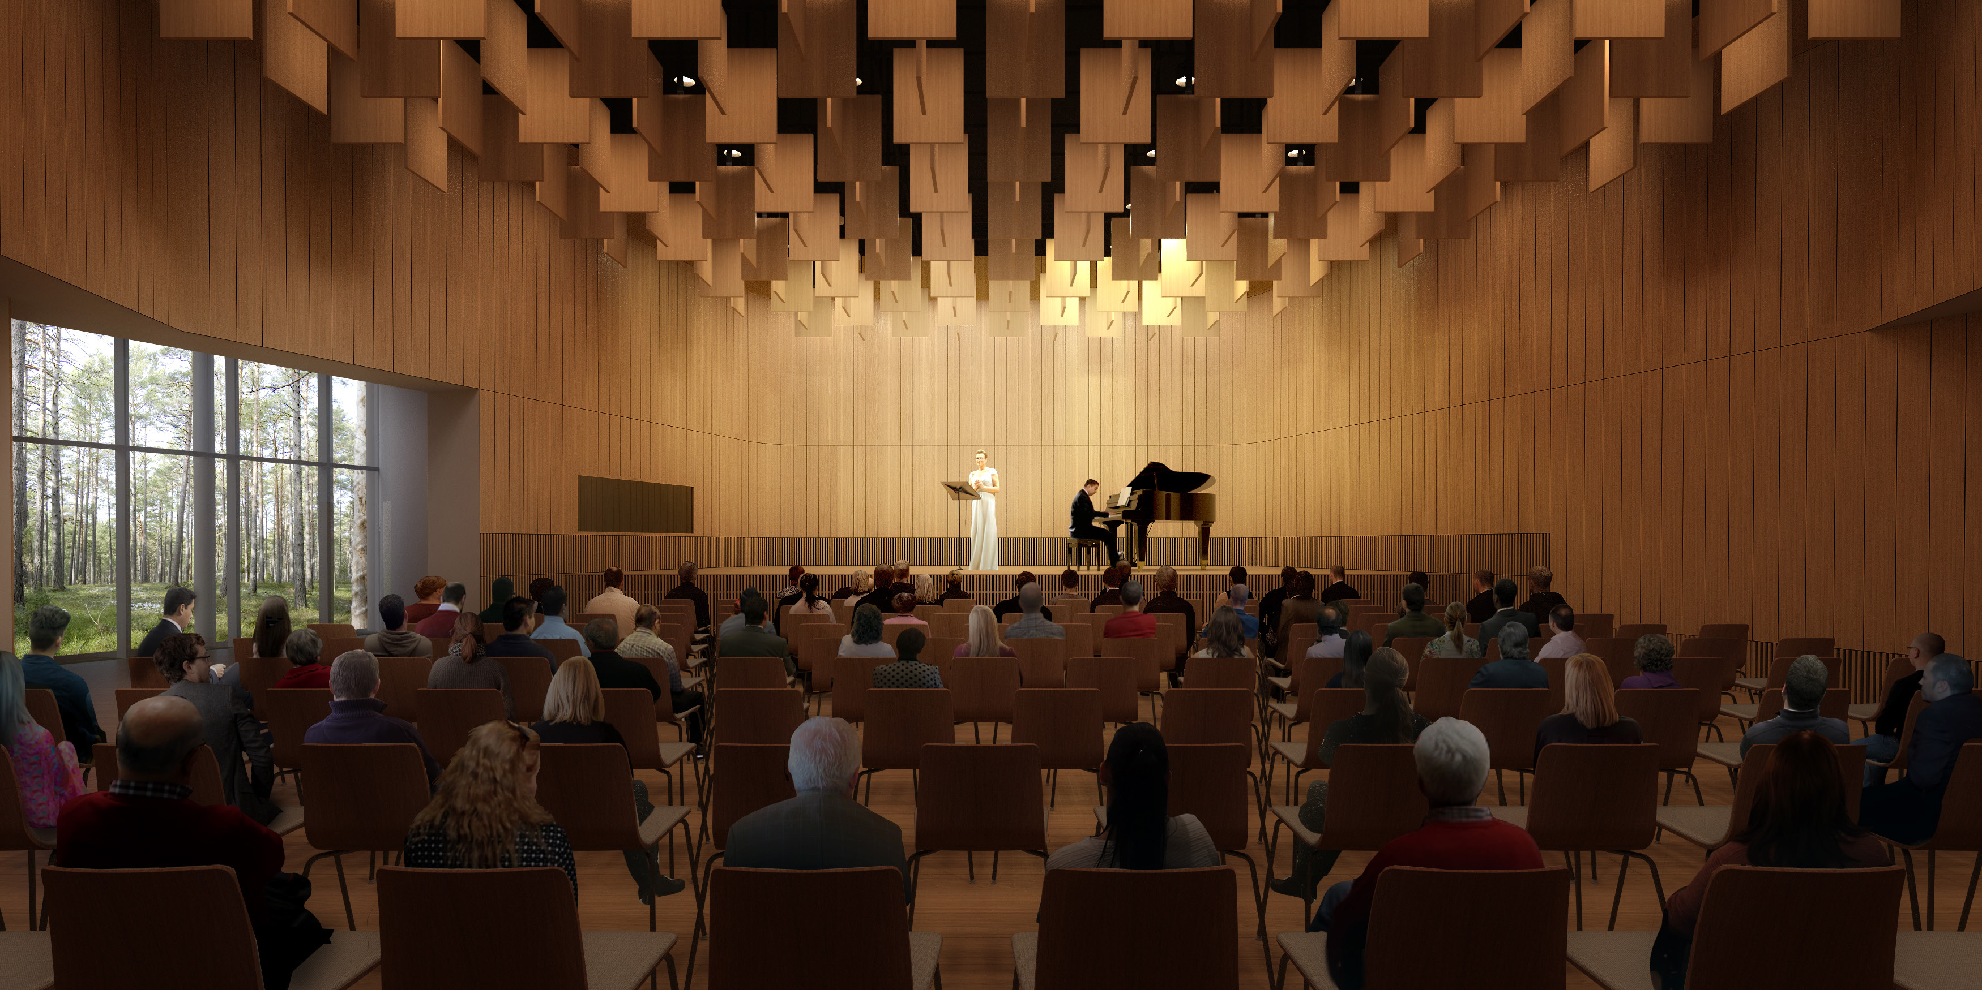
Auditorium: 140 seats

Slide 16
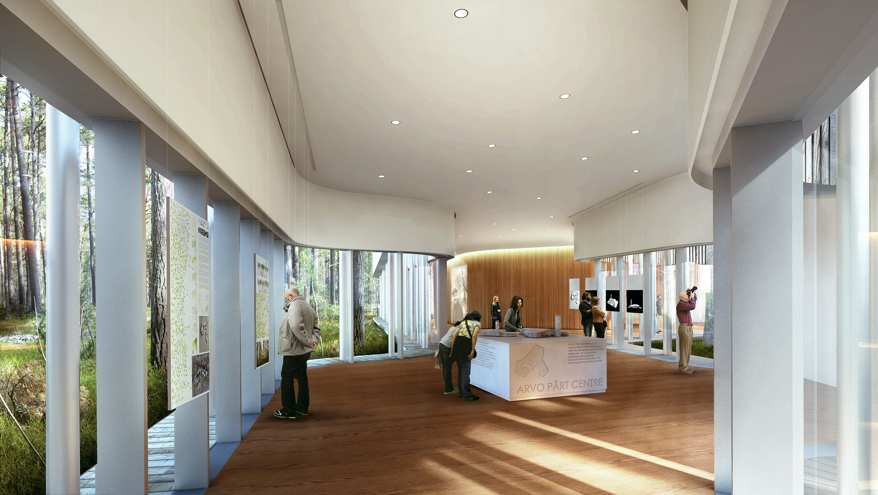
Exhibition area, 170m2

Slide 17
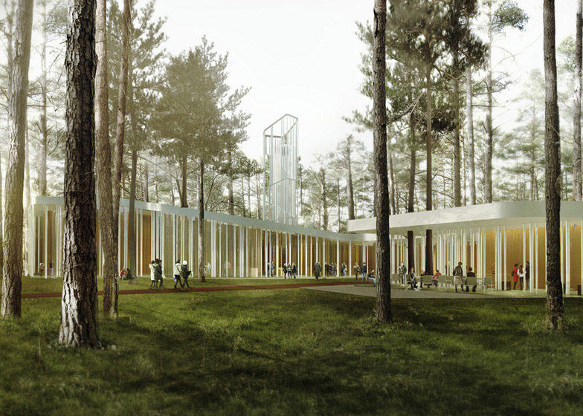
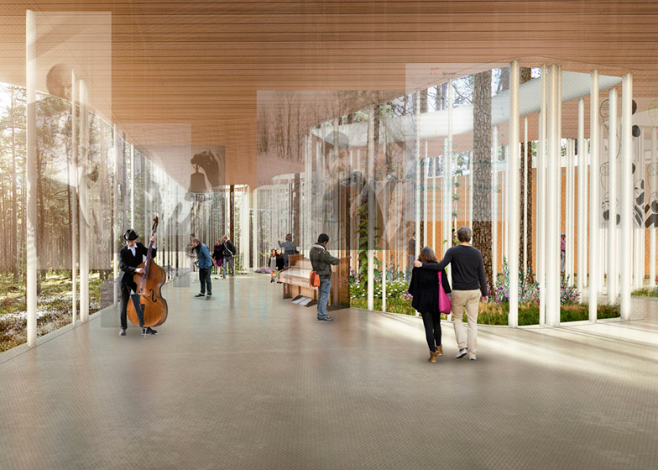
TABULA – impressions
© Nieto Sobejano Arquitectos

Slide 18
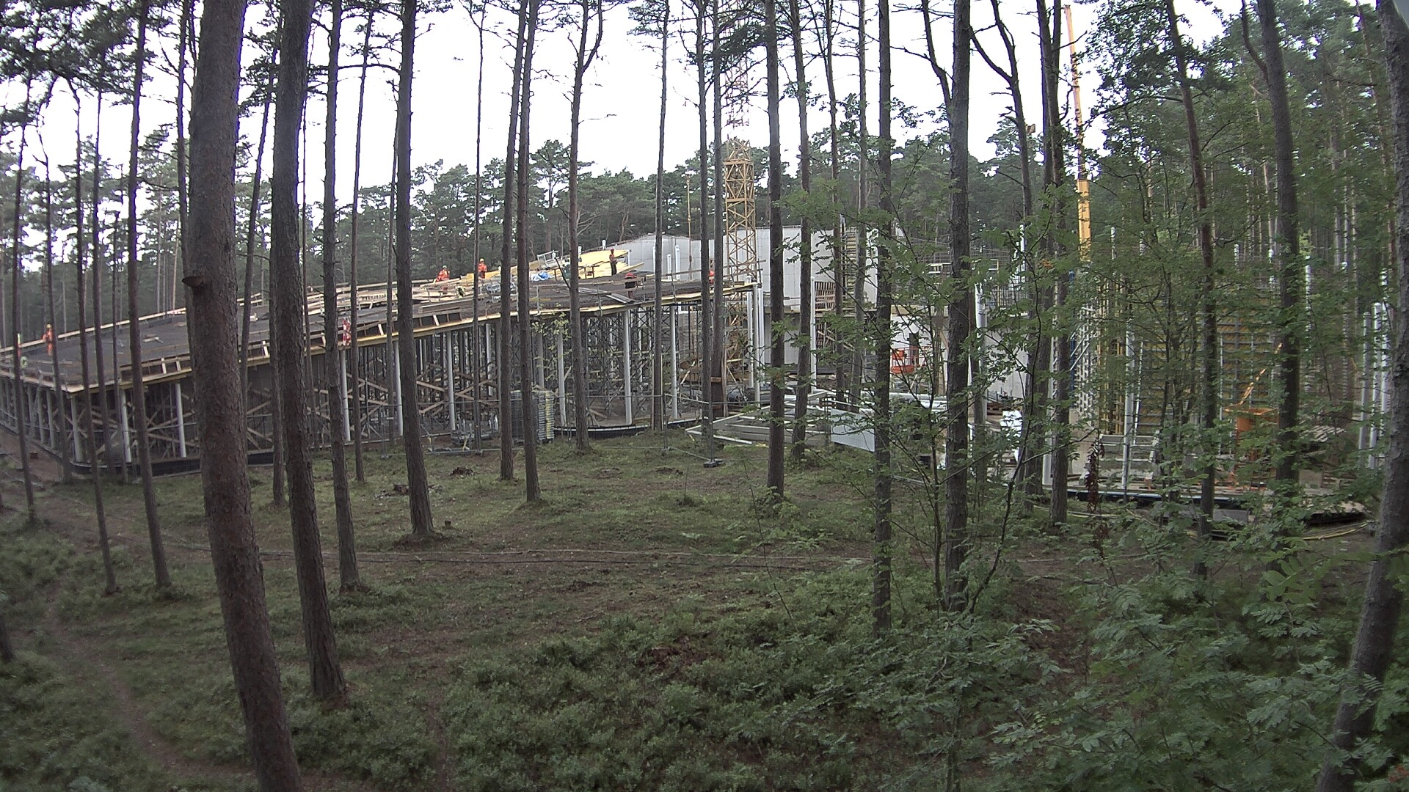
Construction site on August 28, 2017

Slide 19
Welcome to Arvo Pärt Centre at 2018!
Thank you for listening!

