Slide 1
Key features of the European Union’s patent reform European patent with unitary effect Unified Patent Court 10.09.2015
Eskil Waage
European Patent Office, Munich
International Legal Affairs

Slide 2
Three possible routes to obtain a patent in Estonia
Route | National | European | International
Via | Estonian Patent Office | European Patent Office (or via national offices) | International Bureau or European Patent Office or national offices
Valid in | Estonia | Up to 38 countries + two extension states + one validation state | Up to 147 countries
In brief | The patent application is filed with and examined by the Estonian Patent Office. If a patent is granted, it provides patent protection in Estonia only | One single application (processed in English, German or French) for all 38 EPC contracting states A European patent has the same legal effects as national patents | An international patent procedure, not an international patent After the international phase, applicants can choose to enter the national/regional phase in various states

Slide 3
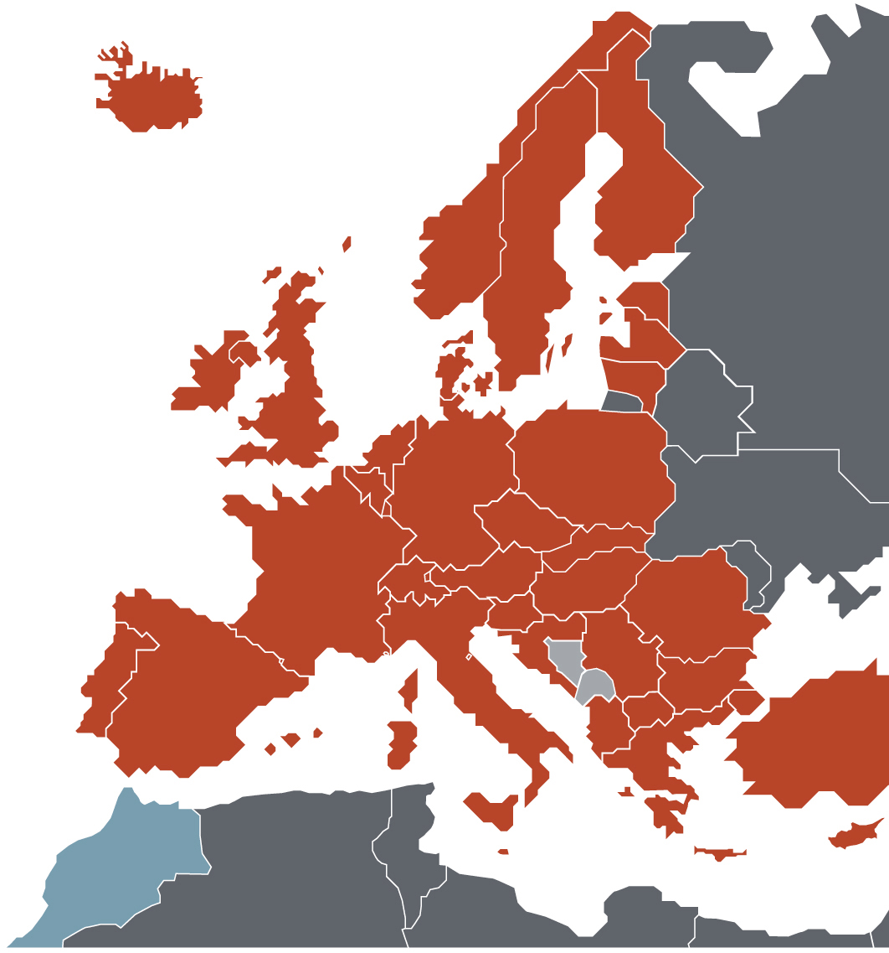
The EPO’s Member States
38 European member states
Belgium • Germany • France • Luxembourg
Netherlands • Switzerland • United Kingdom Sweden • Italy • Austria • Liechtenstein Greece • Spain • Denmark • Monaco
Portugal • Ireland • Finland • Cyprus
Turkey • Bulgaria • Czech Republic
Estonia • Slovakia • Slovenia • Hungary
Romania • Poland • Iceland • Lithuania
Latvia • Malta • Croatia • Norway
Former Yugoslav Rep. of Macedonia
San Marino • Albania • Serbia
2 European extension states Bosnia-Herzegovina • Montenegro
1 Validation state
Morocco

Slide 4
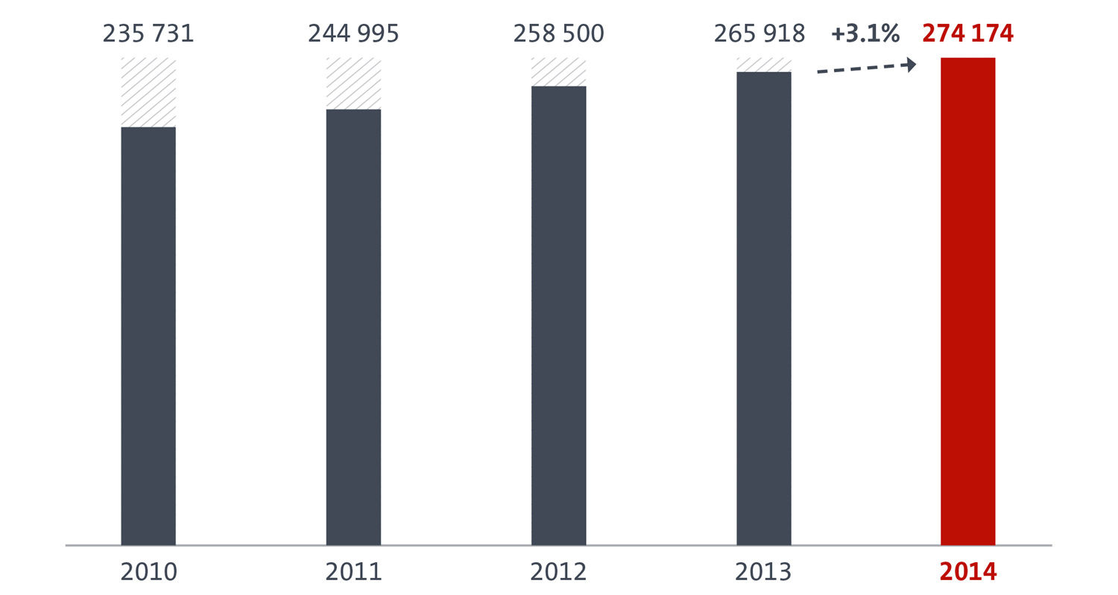
Total European patent filings¹⁾
¹⁾ Direct European filings under the EPC and international filings under the PCT.

Slide 5
Basic steps in the European grant procedure
Filing
Filing
Search
Search
Examination
Grant
Opposition
Appeal
Publication
of the
application
and search report
Publication
of the patent
specification

Slide 6
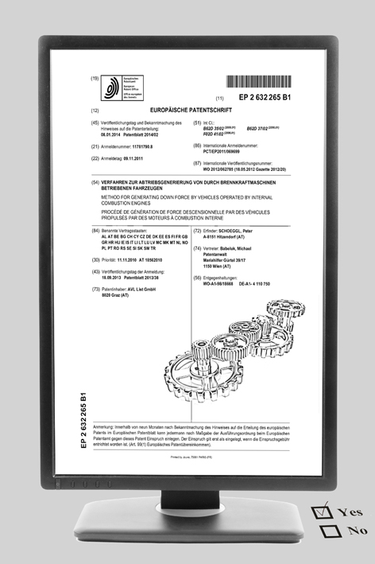
Outcome
If the requirements of the EPC are met, the patent is granted.
If not, the application is refused (with the possibility of appeal).
All granted European patents are published.
For information on the legal status of applications go to www.epo.org/register

Slide 7
Granted patents (2014)¹⁾
EPO Member states
51%
DE: Germany I FR: France I CH: Switzerland I NL: Netherlands I GB: United Kongdom
US: United States I JP: Japan I CN: P.R. China I KR: South Korea I EPO: European Patent Organisation
¹⁾ Analysis based on granted patents in 2014. Patents have been allocated to the country of residence of the first-named patentee.

Slide 8
Today's European patent system
Why a reform of the patent system in Europe?
Shortcomings of the current European patent system
After grant, the European patent is a patent “with national effect” subject to national legal regimes as regards
translation requirements and national renewal fees
infringement, rights conferred by the patent and limitations
licensing, transfers, registers, levy of execution, pledges etc
“unless otherwise provided in the EPC”: Art. 69 & Protocol, Art. 138
High costs and complexity for users
Parallel litigation with risk of diverging national decisions

Slide 9
Today's European patent system
Reform of the patent system in Europe
A project of 25 Member States of the European Union
A legislative “package” composed of
a Regulation (EU) creating a new “European IP right”
the European patent with unitary effect
a Regulation (EU) laying down the language arrangements for the new European patent with unitary effect
a treaty establishing a supranational court to deal with patent litigation
the Unified Patent Court

Slide 10
A. Unitary patent
What is a “European patent with unitary effect”?
It’s a new European IP right
based on a European patent granted by the EPO under the EPC's rules and procedures
to which unitary effect is given for the territory of 25 Member States participating in enhanced cooperation
Requirements
a European patent must be granted for all 25 Member States with same set of claims
formalities
written request by the patent proprietor
within 1 month after publication of mention of grant
1 translation to be filed (during transitional period)

Slide 11
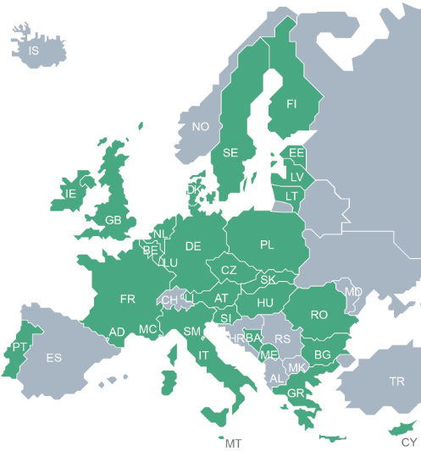
Participating EU Member States
Unitary patent States
Austria • Belgium • Bulgaria • Cyprus • Czech Republic • Denmark • Estonia • Finland • France • Germany • Greece • Hungary • Ireland • Italy • Latvia • Lithuania • Luxembourg • Malta • Netherlands • Poland • Portugal • Romania • Slovakia • Slovenia • Sweden • United Kingdom
Other EPO member states
Spain • Iceland • Switzerland •
Norway • Turkey • Monaco •
San Marino • Liechtenstein •
Croatia • Serbia • Albania • FYROM
11
11

Slide 12
How to obtain a European patent with unitary effect ?
Filing
Filing
Search
Search
Examination
Grant
Opposition
Appeal
Same grant procedure as for a classical European patent
Request
by the
patent
proprietor
European patent with
unitary effect
in the territories of
the 25 Member States
The European patent is deemed not to have taken effect as a national patent
in the 25 Member States

Slide 13
A. Unitary patent
Key features
No fee
No translation (after transitional period)
for information purposes only, no legal effect
New central Register for unitary patent protection
One annual renewal fee payable directly to the EPO
Uniform protection
rights conferred by the patent and limitations
→ see Agreement on a Unified Patent Court (UPCA)
Unitary legal regime
Regulations (EU) 1257 & 1260, EPC, UPCA, national law
Litigation → new Unified Patent Court

Slide 14
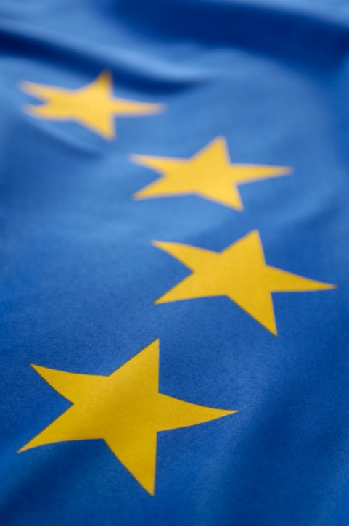
Language arrangements for EP applications
When a unitary patent is requested, translation costs will be reimbursed
for SMEs, universities, public research organisations from the EU
if the European patent application was filed in an EU language other than English, French or German

Slide 15
A. Unitary patent
Renewal fees for the EPwUE
Level of renewal fees agreed in principle by the 25 Member States on 24 June 2015
After intensive discussions in order to arrive at a level …
low enough to be attractive to users
high enough to
cross-subsidise EP granting procedure and
cover the EPO’s costs relating to new tasks and
support activities of national patent offices
Income will be shared between EPO and 25 Member States

Slide 16
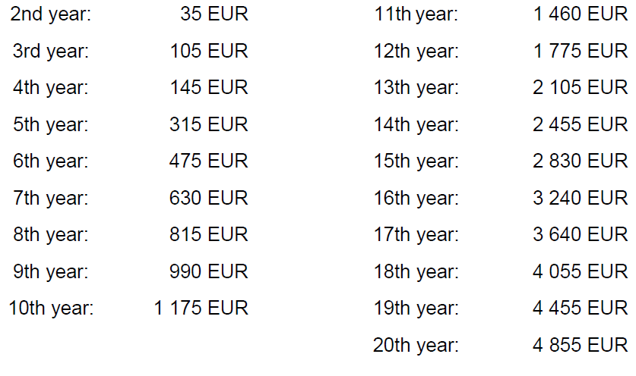
Level of renewal fees : “TOP4”

Slide 17
A. Unitary patent
Costs – Bigger picture
Reduction of “associated costs”
translation, validation, representation
“One-stop shop” at the EPO
– centralised post-grant administration
central register → facilitate portfolio management
Broader geographical scope
better protection at the EU’s external border
increased potential for licensing
more security for R&D investments in the 25 Member States
----------------------------
Costs of litigation before the Unified Patent Court
court fees + representation
No “one-size-fits-all”
– but a new option

Slide 18
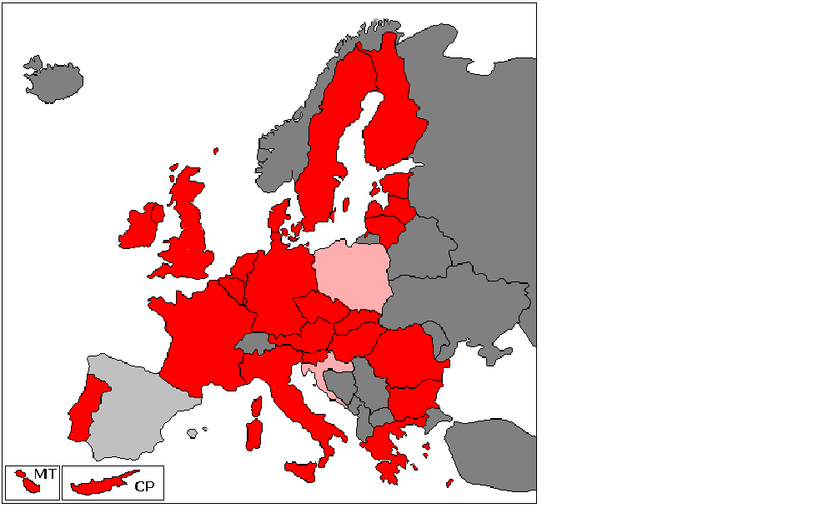
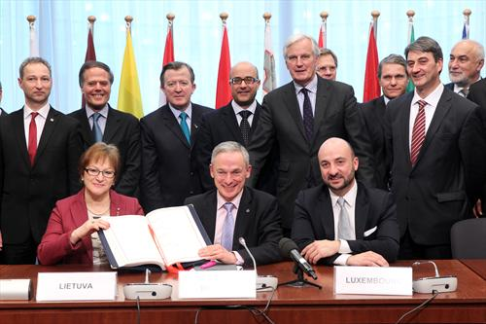
Today's European patent system
Unified Patent Court
Agreement on a Unified Patent Court
an international treaty establishing a supranational court
signed by 25 EU Member States on 19 February 2013
ratified so far by 8 Member States
AT, BE, DK, FR, LU, MT, PT, SE

Slide 19
Unified Patent Court
Unified Patent Court
Supranational court
dealing with disputes between private parties
specialised in patent litigation
Not an institution of the European Union
but linked to the Court of justice of the European Union as any national court → request for preliminary opinion
Decentralised Court of First Instance composed of
a central division
with seat in Paris and sections in London and Munich
[15 or 18] local divisions
[2 or 3] regional divisions
Centralised Court of Appeal, in Luxembourg

Slide 20
Court of Appeal
with seat in Luxembourg
Court of Justice
of the
European Union
Requests
for
preliminary
rulings
Appeals
based on
points of law
matters of fact
Court of First instance
One central division
Several local divisions
set up in the Member States
A few regional divisions
set up jointly by several
Member States
Seat in
Paris
–
Office of
President of CFI
(B)(D)(E)(G)(H)
Section
in
London
–
(A)(C)
Section
in
Munich
–
(F)
Training
Centre
for judges
Budapest
LD
LD
LD
LD
RD
LD
LD
…
LD
…
LD
RD
Patent Arbitration
and Mediation
Center
Lisbon & Ljubljana
will mostly hear
revocation actions and (in case of bifurcation)
counterclaims for revocation
actions for declaration of non-infringement
actions against decisions of the EPO re. UPP
will mostly hear
infringement actions and counterclaims for revocation
actions for provisional and protective measures and injunctions
actions for damages or compensation (provisional protection, licences of right)
actions relating to the right based on prior use of the invention

Slide 21
Unified Patent Court
Unified Patent Court – 5 key features
Judges
Mix of legally qualified judges & technically qualified judges
Always internationally composed panels
Exclusive competence in respect of
infringement
validity
provisional and protective measures and injunctions
Transitional period of 7 years (extendable)
possibilities to escape from the UPC’s exclusive competence
but only for EP and EP applications
> Opt-out scheme and choice of national court

Slide 22
The Unified Patent Court – Key features
Unified Patent Court – 5 key features
4. Mandatory representation by either
lawyers authorised to practice before national courts or
European Patent Attorneys with appropriate qualifications
5. Court fees: basic fee for starting action plus value-based fee
Proposals → http://www.unified-patent-court.org/consultations
Fee reduction for SME?
Infringement action | 11.000 €
Revocation action | 20.000 €
Appeal | 16.000 €
Value of action | Additional fee
From 500.000 up 750.000 € | 2.500 €
Up to 1.000.000 € | 5.000 €
... | ...
Up to 5.000.000 € | 30.000 €
... | ...
Up to 30.000.000 € | 150.000 €
More than 30.000.000 € | 220.000 €
Application for opt-out – per patent | 80 €

Slide 23
When will it all start?
European applications already "in the pipeline" today might be given unitary effect if granted after the system starts
Minimum of 13 States − including France, Germany and UK − must ratify the Agreement on a Unified Patent Court
First unitary patents will cover only the States which have ratified the Agreement, then more as States accede

Slide 24
Thank you for your attention
Directorate International Legal Affairs, PCT
International_Legal_Affairs@epo.org

