Slide 1





Tallin, 11 September 2015:
Technology Transfer
Capacity Building Across Europe
Karl Klingsheim, RTTP, Professor Dr.Ing.
- CEO, NTNU Technology Transfer AS (www.tto.ntnu.no)
- President-Elect, ASTP-Proton (www.astp-proton.eu)

Slide 2
Innovation is at the core of the university
Dissemination of knowledge for the benefit of business and society at large.
Dissemination
↓ innovation
Research ↓
new knowledge
Teaching ↓
competence
Scientific research and the creation of new technology.
Professional, general, and post-graduate education.

Slide 3

USA pioneered university-industry partnership
“Possibly the most inspired piece of legislation to be enacted in America over the past half-century was the Bayh-Dole act of 1980.”
“Innovation's Golden Goose”
The Economist
12 December 2002

Slide 4


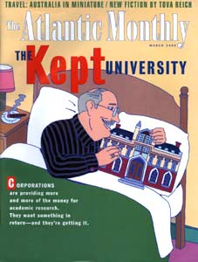

… and an opposing “movement” (in USA)

Slide 5
Inherent dilemmas – or tradeoffs? (1/2)
At the philosophical/strategic level:
Fundamentally, is techtrans a business or a service? Are we an integral part of the university’s effort to disseminate knowledge effectively – or is our role to ensure fair and reasonable quid-pro-quo for the PRO’s intellectual assets?
Compatibility – with the university or with industry?
Governance – owned by the university or independent?
TTO staff – “us”, “we” or “them” to the university?
Researchers – are they masters, customers or clients?
“Open innovation” – is it supportive or detrimental to TT?
IP stewardship – license the IP or assign it?
NPE’s and “trolls” – good guys, bad guys, or just like us?

Slide 6
Inherent dilemmas – or tradeoffs? (2/2)
At the operational level:
Money – the means to an end or the end in itself? Can we operate like a business with a “benefit to society” purpose
– or will financial returns rule regardless?
Success criteria – number of DOFIs, patents, deals, exits or net profits? – or happy customers?
Operational model – “do the best you can with the funds available” (like the rest of the university) or “manage by objectives” (and leverage a balance sheet)?
Preferred partners – big corp. or start-ups?
Spin-off exit – maximize profits or benefit society?
Loyalty – siding with the VCs or with the entrepreneurs?

Slide 7
US technology transfer – best practice
1st generation – Implementing Bayh-Dole (1980):
  Making money for the university?
  A lot of people think it is…
2nd generation – Interaction with investors:
  Get the technology developed
  Give the public the benefit of the research they fund
  Allow investigators to “make their findings real”
  Bring real world problems into the laboratory
3rd generation – Integration with industry:
  Integrating all commercialization activities
  Integrating commercialization activities with research
  Integrating commercialization activities with education
(source: Ashley Stevens, Boston University, 2007)

Slide 8
European (and global?) trends
Growing emphasis on IP in business.
  IP valuation, competition, and litigation is increasing.
Global financial crisis.
  The funding gap for new projects/ventures is widening.
Innovation is essential for new jobs.
  Social responsibility is gaining awareness/popularity.
Entirely new business models are emerging
  Open innovation is gaining momentum.
Public funding for universities is decreasing.
  Universities are ramping up commercial activities.
Growing demand on faculty members to publish.
  Less compatibility between university and industry.

Slide 9

Notes:
It’s all about creating IMPACT now days.

Slide 10



Public
INVESTMENTS
in research ...
Taxpayers are demanding IMPACT
to continue fund research
Technology Transfer =
the dissemination of knowledge from academic research,
with the intent to induce innovation and facilitate growth
in an economically profitable
and socially sustainable way.
... must yield
RETURNS
to society!

Slide 11

An “ecosystem” approach is essential!

Slide 12

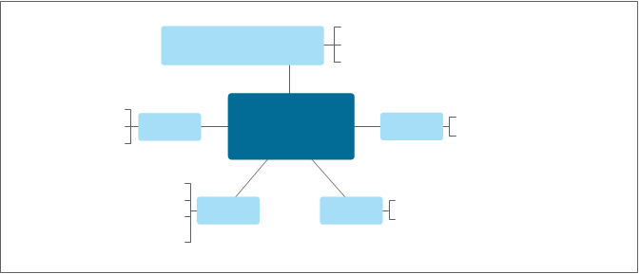
TT Ecosystem

Slide 13





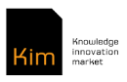




“Capacity Building Strategy for Practitioners of Technology Transfer”
The PROGRESS-TT project has received funding from EU’s Horizon 2020 Research and Innovation Programme.
is project manager of a consortium:
Objective:
  Contribute to Europe’s economic growth by ensuring Public Research Organisations (PROs) are better equipped to transfer valuable knowledge to industry.

Slide 14
Why?
The public sector funds 36% of all R&D spending in Europe.
Europe is lagging USA in capitalizing on this investment.
Sleeping patents should be exploited.
10% of European PROs secure 80% of all licensing revenue.
Underperforming TTOs must learn from top-performing TTOs.
CBS must focus also on stakeholder groups, not only on the TTOs.
CBS is a framework around which operational sub-strategies hae to be aligned.

Slide 15
Context: Potential, Ambition, Capacity
“Generic” technology transfer doesn’t exist – nor “one size fits all”.
Instead each particular context must be clearly understood and defined:
Potential, as in the size and the relevance of the research base: Number of researchers, quality of research, fields of research, international reputation/recognition, industry relations, joint research with others, etc.
Ambition, reflecting the level of strategic emphasis, awareness and priorities: Institutional, regional, and national legislation, policies, strategies and operational incentives.
Capacity, defining operational capabilities: The size, experience and maturity of a dedicated organization with TT professionals, their access to relevant funding and to a complete “ecosystem” for technology based innovation.
The purpose is to create a foundation for institution-specific development aiming at improving quality and expanding TT capacity.

Slide 16
Capacity Building:
Picture, Pieces, Process, and People
A plan for capacity building must contain the following elements:
The picture derived directly from the context description, defining the overall scope of capacity building at the individual institution and how it relates to local, regional and national considerations.
The pieces and the different elements that must be developed and their relationship necessary to implement the picture.
The process by which the pieces must be developed and integrated.
The people needed to produce the results, including qualifications, skills, and training requirements.
ASTP-Proton is the premier, pan-European association for professionals involved in knowledge transfer between universities and industry. By promoting and professionalizing knowledge transfer practice, ASTP-Proton aims to enhance the impact of public research on society and the economy.

Slide 17

Success criteria
For the TTO:
Number of deals
Customer satisfaction
Student involvement
Awareness among researchers
Credibility with external partners
Sustainability of TTO operations
For the university/PRO:
Improved reputation and stronger brand
Obtained additional research funding
Effective dissemination of knowledge → IMPACT!
Notes:
17

Slide 18
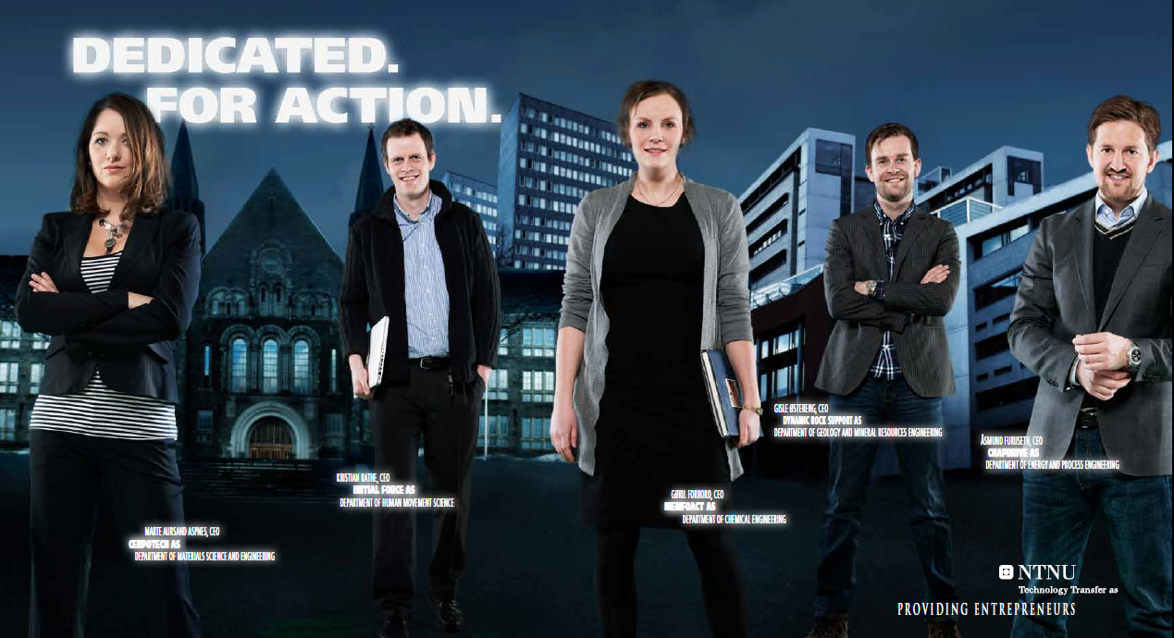
It’s all about people!
Thank you for your attention.

