Slide 1
University cooperation – an essential part of Outotec´s research agenda
Dr. Asmo Vartiainen
Director – Technology portfolio
Outotec Oyj

Slide 2
Content
About Outotec
University cooperation as a part of Outotec’s research
EIT Raw Materials network
Summary

Slide 3
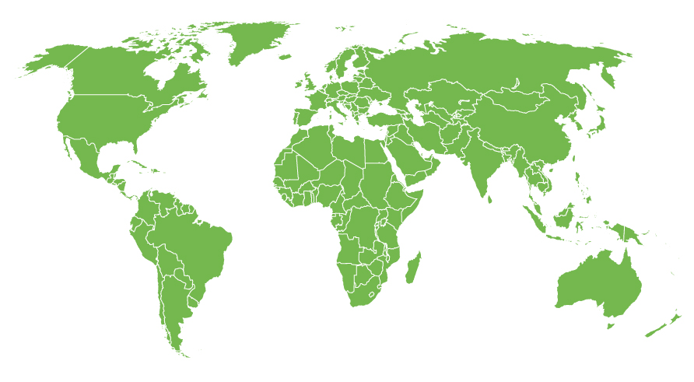
Outotec in nutshell
Sales
1.4bn
EUR*
4,571
employees*
Deliveries to more than
80
countries
Presence in
30
countries
12th most sustainable company in the world
Experts of over
60
nationalities
6,796 national patents /
applications
Outotec R&D, sales and service centers
Outotec manufacturing / assembly
* in 2014

Slide 4
Outotec – a process technology company
The 12th most sustainable company of the world (2015)
Outotec provides leading technologies and services for the sustainable use of Earth’s
natural resources.
As the global leader in minerals and metals processing technology, we have developed many breakthrough technologies over the decades for our customers in mining and metals industries.
We also provide innovative solutions for industrial water treatment, the utilization of alternative energy sources and the chemical industry.
Outotec shares are listed on NASDAQ Helsinki.

Slide 5
Strategic intent and focus in the value chain
The leading provider of sustainable
minerals and metals processing solutions...
... and an innovative provider of sustainable energy and water processing solutions
Leadership in sustainable technology
Industrial water treatment
Energy
Minerals processing for all ore types
Metals refining of all ore types
Life-cycle services
Sustainable end-to-end solutions from feasibility studies to complete plants and life cycle services for virtually all ore types
Extensive range of sustainable process solutions for virtually all types of ores and concentrates and sulfuric acid, turn-key delivery and life cycle services
Solutions to produce water that meets environmental discharge standards, maximize water recycling and reduce water and energy consumption
Innovative solutions for biomass, agricultural and municipal waste, industrial byproducts, as well as oil winning from oil shale

Slide 6
Outotec’s business is based on addressing the global sustainability challenges
Sustainable process technology for:
minerals
metals
water
energy
Welfare
Eco-efficiency
Environmental impact
Environmental impact

Slide 7
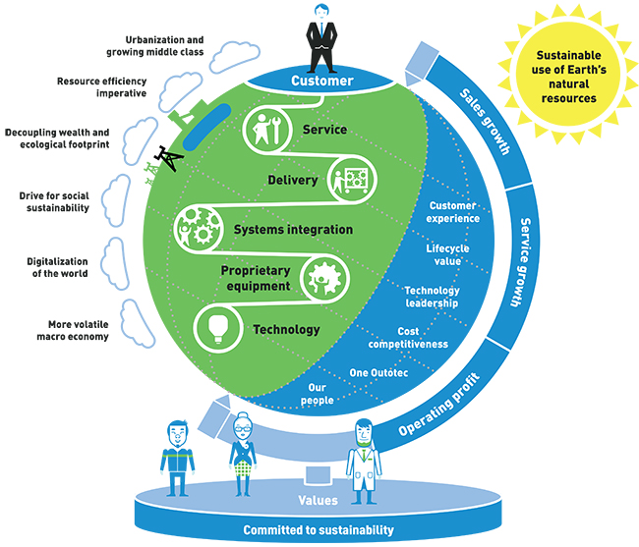
The best return on customers' investments through industry leading sustainable process technology solutions and services

Slide 8

Positive impact of our technologies
Our handprint is bigger than our footprint
Our long-term targets
20% reduction in potential CO₂ emissions through use of our metals-related processes
(2014: 5.9 million tonnes CO₂ emissions avoided)
50% reduction in fresh make-up water in non-ferrous metals concentrators
Environmental Goods and Services in order intake permanently over 90% (2014: 90%)
More energy generated through Outotec waste-to-energy solutions

Slide 9
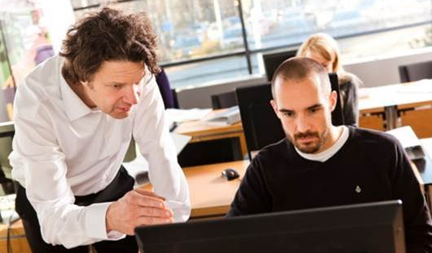
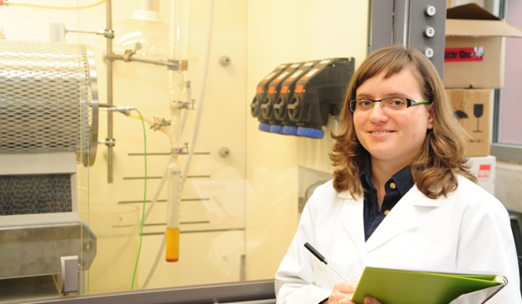
Promoting strong open innovation culture
Our R&D expenditure in 2014 was EUR 57 million
We have 749 patent families, including a total of 6,796 national patents or patent applications
Outotec had the highest
number (55) of patent applications in Finland in 2014
We award employees with technology prizes
We cooperate with universities, research institutes and our customers in R&D

Slide 10
Content
About Outotec
University cooperation as a part of Outotec’s research
EIT Raw Materials network
Summary

Slide 11
Options to manage Technology Portfolio
M&As
Immediate access to new markets and resources
Strong IPs and technologies
Own R&D
Utilization of own knowledge base
To maintain the leadership position
In-licensing
Immediate access to technologies or knowledge
License fee based on one time fee or success fee
Alliance / Partnering
Joint ventures
Synergies with our existing technologies and business
Development work for customers
Creation of own IP and proprietary equipment
Long development time
Shortens the development time
Improves the competitive position
Profit sharing
Strenghtening offerings and resources
Access to new markets or new applications
Collaboration
Outsourced technologies
First stage to deeper collaboration
Collaboration with customers or research institutes or universities
Securing resources or capabilities
Complementary or outsourced technologies
Key technologies
Spear head technologies or leading technologies
Divestments
Selling of non-compatible technologies or businesses
Synergies with other technologies are low
The life-cycle of the product is close to its end

Slide 12
Research and Development at Outotec
Research and Technology Development is carried out at corporate level and in all business divisions.
R&D creates sustainable added value to Outotec and its customers by
  developing new products and technologies
  improving existing metals production technologies
  participating in transferring technological knowledge to products and business.
Close cooperation with Outotec’s customers is key success factor. This ensures that R&D is business-oriented.
We continuously take care of developing our competencies and research methods in order to strengthen our position at the top of innovative metallurgical research.

Slide 13

Why R&D in a technology-providing company?
Need to develop, update and maintain proprietary technologies and processes as long-life products
Flexibility & Customizing tool for matching current technologies to the changing market needs
Driver of company growth and portfolio development
Source of new IPR
Platform for alliances with selected clients and vendors
Knowledge development and in-house know-how sharing/transfer tool
Important differentiation factor
Product
R&D
Client A
Client B

Slide 14
Networked R&D
Networked R&D is very important, promotes “semi-open” innovation
Good contacts with universities, long tradition
Several cooperation projects ongoing, in Finland funding from Tekes – the Finnish Funding Agency for Technology and Innovation is effectively used (so far…)
Development work carried out with partners (mutual funding)
IP issues very often critical
  Different expectations from parties in creating value with IP
  Solutions are anyhow mainly tailor made
  In many cases the developed IP can be used to different solutions

Slide 15
Long cooperation programs
Metals producers in Finland have a long cooperation tradition in research
  Five year programs funded by Tekes
  1984-1989: Continuous casting in steel production
  1988.-1993: Melt 1
  1993-1998: Melt 2
  1999-2003: Metallurgy opportunitites
  2003-2009: New processes
  2009->: Several FIMECC (Finnish Metals and Engineering Competence Cluster) programs
  Companies such as Outokumpu, Rautaruukki (SSAB), Ovako, Boliden, Norilsk, Outotec and some others
  Technical Universities such as Aalto, Oulu, Lappeenranta, Tampere, Åbo Akademi, research institute VTT

Slide 16
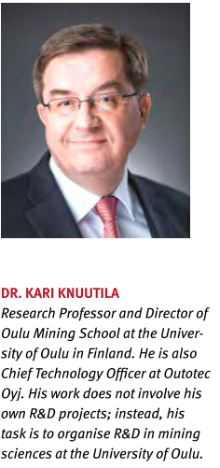
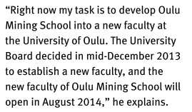
Universities and Outotec
Our research is done in cooperation with professors and academic elite
  Various funding possibilities; national, EU, direct funding
We keep our topics on the universities’ agenda
  Active as well in university policy and teaching, research discussions
We keep in contact with potential future employees through diploma/doctoral thesis work for Outotec
  Very active through e.g. Tekes-projects
Ensures the continuity of education related to our expertise
We regard universities as an integral part of the Outotec’s R&D

Slide 17



























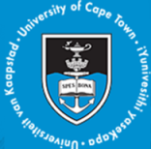










Co-operation network of Outotec

Slide 18
Content
About Outotec
University cooperation as a part of Outotec’s research
EIT Raw Materials network
Summary

Slide 19

EIT (European Institute of Innovation and Technology)
The EIT is an EU body that enhances Europe’s ability to innovate by nurturing young entrepreneurial talent and supporting new ideas through the Knowledge and Innovation Communities (KICs).
The EIT is the first EU initiative bringing together the three sides of the “knowledge triangle”: business (companies and SMEs), higher education institutions and research centres.
The EIT aims to increase the cooperation and integration between higher education, business and research to facilitate the transition from:
student to entrepreneur
idea to product
lab to customer

Slide 20
EIT Community

Slide 21
KIC EIT Raw Materials
Accepted after competition as a new KIC in December 2014
Mission:
to boost the competitiveness, growth and attractiveness of the European raw materials sector via radical innovation and entrepreneurship.
Vision:
to develop raw materials into a major strength for Europe
Goals:
Creating and developing new game changing businesses across Europe;
Boosting the existing RM sector through the market introduction of new materials, investment in new production and processing units,
system integration and the setting up of new partnerships across the value chain using innovative ICT solutions and smart product design;
Creating new entrepreneurial education approaches addressing the development needs of graduates and professionals in the RM sector to support the effective transformation of ideas into businesses and contribute to a resource and cost-efficient industry.

Slide 22
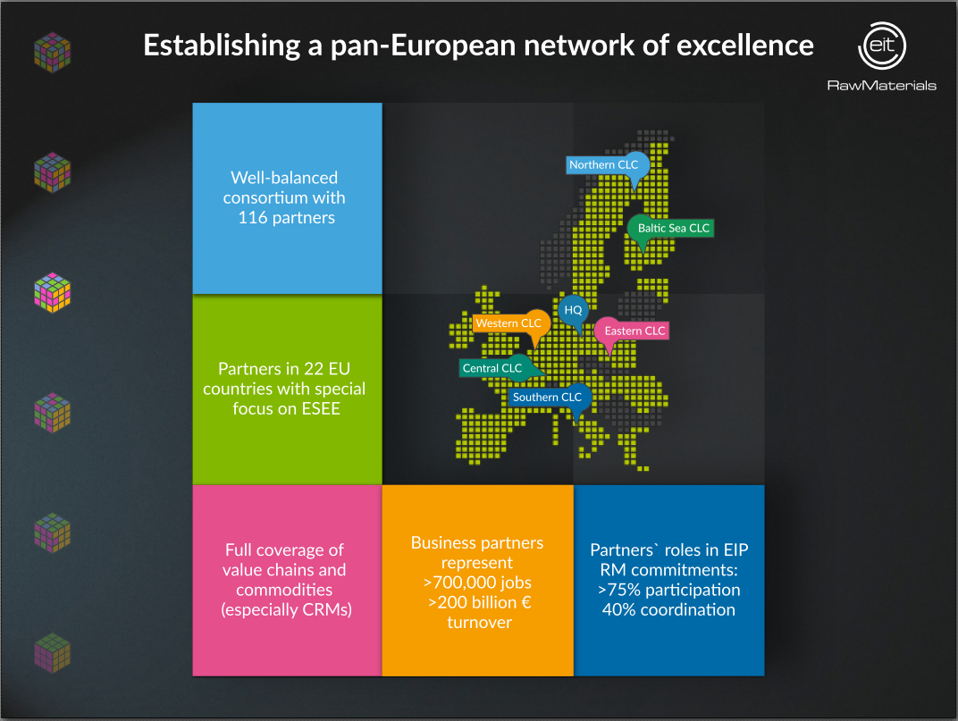

Slide 23

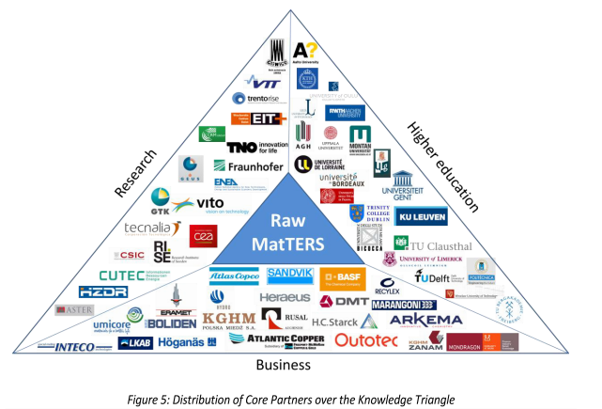
Baltic Sea CLC - Otaniemi
Actions in the whole EIT Raw Materials area realize as projects in several CLC´s with partners
EIT funding for KAVA (KIC Added Value Activities)-projects focused on innovations, entrepreneurship and education
Natural cooperation network for e.g. H2020 calls
Total budget for EIT Raw Materials (75% KCA + 25 % KAVA) years 2016-2022 about 2.0 billion euros.

Slide 24
Content
About Outotec
University cooperation as a part of Outotec’s research
EIT Raw Materials network
Summary

Slide 25
Outotec and innovativeness in R&D
strong market position and technology leadership based on experience gathered over the decades
one of the world’s leading process solution, technology and service providers for the mining and metallurgical industry
knows the whole value chain from minerals to metals and maximizes the metals recovery with low unit costs
the customers’ partner throughout the life cycle of the plant
success based on extensive research and development and proprietary technologies that are environmentally sound and energy-efficient
able to design the most efficient solutions for its customers and guarantees process performance
networking in R&D needs a proper R&D and technology portfolio steering and close cooperation with universities

