Slide 1
“Horizon” is on the horizon
26.2.2013

Slide 2
EIT ICT Labs
Kai Huotari
Co-Location Centre Manager
EIT ICT Labs Helsinki

Slide 3
Agenda
EIT initiative
Our Mission
The Way We Operate
The Helsinki Node
How To Get Involved

Slide 4
EIT Initiative

Slide 5
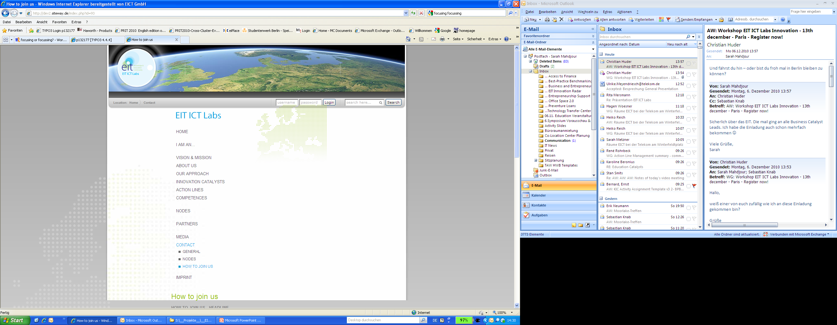
Tackling the European Paradox
The European Paradox refers to the presumption that EU member states play a leading global role in terms of top-level scientific output, but lag behind in the ability of converting this strength into wealth-generating innovations.
The EIT was established as a new EU instrument for promoting innovation in Europe: from idea to product, from lab to market, from student to entrepreneur.
It does not replace other existing EU initiatives (e.g. EU Framework Programmes), but adds to them by setting its focus on bringing research results to market

Slide 6




The EIT and its KICs
The European Institute of Innovation & Technology (EIT) was legally established in 2008 as an independent agency within the EU
It funds Knowledge and Innovation Communities (KICs)
  Official call and selection of the first three KICs in 2009
  First KICs fully operational in December 2010
KICs
Climate KIC
EIT ICT Labs
KIC InnoEnergy

Slide 7
Our Mission

Slide 8
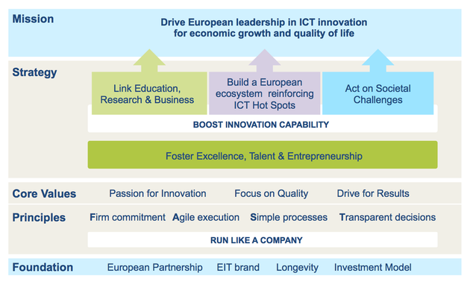
Our mission is to turn Europe into a global leader in ICT innovation, creating value and jobs for Europeans

Slide 9
Innovate across Education, Research and Business
Creating a new breed
of entrepreneurs
Enabling excellent individuals
and multidisciplinary teams to develop breakthrough ideas
EIT Master Schools
MSc
Schools & Camps
Education
Research
Experience Labs & Living Labs
Co-location Centres
Test Beds &
Simulation Tools
Cross-
Sectoral
Mobility
Business
Innovation
Radar
Supporting innovators all the way to the market
Notes:
Educate a new generation of business savvy ICT professionals
Combine Europe’s excellence in ICT to foster world-leading ICT innovations
Create a business-minded framework for ICT innovations
Establish a network of world-class co-location centres to foster new ideas

Slide 10
The Way We Operate

Slide 11
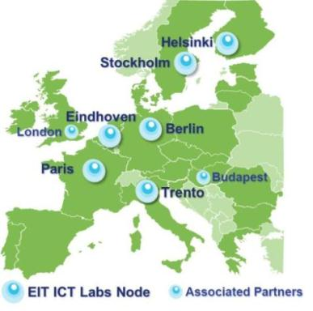

Co-Location Centres
European Innovation Hotspots
  EIT ICT Labs operates from Co-location Centres (CLCs) in 6 nodes
  CLCs are places where individuals from different types of organisations and cultures work together face-to-face and move forward effectively towards KIC goals
  CLCs are equipped with state-of-the- art communication technologies that facilitate cross-node collaboration
Madrid

Slide 12
EIT ICT Labs unites European top ICT players from academia and industry
Universities
Core Partners
Aalto University
3TU / NIRICT, comprising TU Delft, TU Eindhoven, University Twente
TU Berlin
Université Pierre et Marie Curie
Université Paris-Sud 11
Institut Telecom
KTH
Affiliate Partners
Karlsruhe Institute of Technology (KIT)
Luleå University of Technology
Lund University
Saarland University
Stockholm University
Tampere University of Technology
TU Darmstadt
TU München
Turku Center for Computer Science (TUCS)
University of Helsinki
University of Nice Sophia Antipolis
University of Oulu
CIE-Center for Internet Excellence
CWC-Center for Wireless Communications)
University of Rennes 1
University of Tampere
Associate Partners
Imperial College London
University College London
Eötvös Lorand University of Sciences (ELTE) (Budapest Associate Node)
Research Institutes
Core Partners
DFKI
Fraunhofer
INRIA
Novay
VTT
SICS
Affiliate Partners
Max Planck Institute
CWI
Embedded Systems Institute (ESI)
Holst Centre
TNO-ICT
Digiteo
Acreo
IT Center for Science (CSC)
Cap Digital
COMICT
Images & Réseau
KTH Chalmers Capital
Point One
Oost VC
SITRA
System@tic
Technology Circle Twente
3TU Innovation Lab
Companies
Core Partners
Deutsche Telekom
SAP
Siemens
Philips
Nokia
Alcatel-Lucent
Orange France Telecom
Ericsson
Affiliate Partners
EICT GmbH
Opera Software ASA
Logica
Hermia Ltd
Futurice Ltd
Electrum Foundation
Secured Communication Systems
Technopolis Ventures
STING
Associate Partners
Intel labs Europe
Notes:
CIE-Center for Internet Excellence
CWC-Center for Wireless Communications)
University of Tampere
Holst Centre
Digiteo
Logica

Slide 13
The Catalyst-Carrier model is key in our approach
Specific Innovation
Catalyst
Carrier
co-funding
€
complementary
funding
€
EIT Funding
Non-EIT Funding

Slide 14
Catalysts 2013
Common Catalysts
KIC Management
lead the KIC to make it a leading force in ICT
Co-Location Centres
lead nodes and CLCs towards world-class
Best-Practice Benchmarking
integrate global best-practices to create a self-re-enforcing innovation ecosystem
Action Line Management
lead an action line towards its goals
Workshops and Conferences
consolidate goals, plan joint work, share results, create networks, gain visibility
Mobility Program
foster inter-node and inter-domain mobility of educators, researchers and innovators
Activity Management
lead an activity towards its objectives
Project Proposal
catalyse ERB carriers matching our strategy
Education Catalysts
Research Catalysts
Business Catalysts
I & E Education for MSc Programs
integrate robust entrepreneurship education for EIT ICT Labs M.Sc. programs
Open Source Booster
catalyse industrial take-up of open source flagship projects
Innovation Radar
create business intelligence of the future
I & E Education for PhD Programs
integrate robust entrepreneurship education for EIT ICT Labs doctoral programs
Patent Booster
intensify creation of new patents
Strategic Coaching
coach start-ups towards growth strategies
Test Beds, Testing Platforms & Simulation Tools
integrate joint hardware or software platforms to experiment and validate technologies or applications
Access to Finance
ensure capital availability for all stages
Professional Training
provide professional training to industry
Technology Transfer
increase the flow of technologies from academia to companies
Doctoral Training Centre
integrate doctoral training with industry
Experience & Living Labs
test and modify product and service designs with real users and use contexts
Technology Scouting
seek opportunities for business incubation
Quality Assurance and Accreditation
assure quality of educational programs
Summer and Winter Schools and Camps
provide intensive educational events
Business Modelling
provide techno-socio-economical modelling of a business domain
Standards Booster
foster impact and ensure sustainability of key results
Student Mobility
coordinate student mobility
Soft Landing
help SME’s to grow to European level
Entrepreneurial Research
stimulate entrepreneurial research in the community
Thematic Alignment of Technical Majors align the content M.Sc. programs with SIA
Entrepreneurial Talent Scouting
link entrepreneurs to innovators

Slide 15





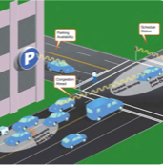
Action Lines for Societal Challenges
In Smart Spaces we will create intelligent environments that facilitate everyday practices, create richer user experiences and enhance the users’ awareness of local opportunities in a resource and cost efficient way.
In Smart Energy Systems we address the issue of increasing energy efficiency via ICT enabled power grids, as well as energy efficient ICT solutions - green ICT.
In Health and Well-being we will improve the quality of everyday life via the development of ICT enabled services supporting a cost effective sustainable healthy lifestyle, as well as ambient assisted living.
In Digital Cities of the Future we improve the living conditions for citizens in large urban conglomerations via ICT enabled solutions in the areas of security, pollution, transportation, and resource management (e.g. water).
In Future Media and Content Delivery we develop of a powerful and open ICT infrastructure, capable of delivering rich data-intensive media and content storage services, at competitive costs, across administrative domains, ensuring quality of service.
In Intelligent Transportation Systems (under construction) we enhance services for people using all kinds of transportation systems.

Slide 16
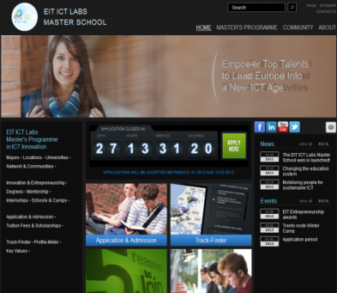
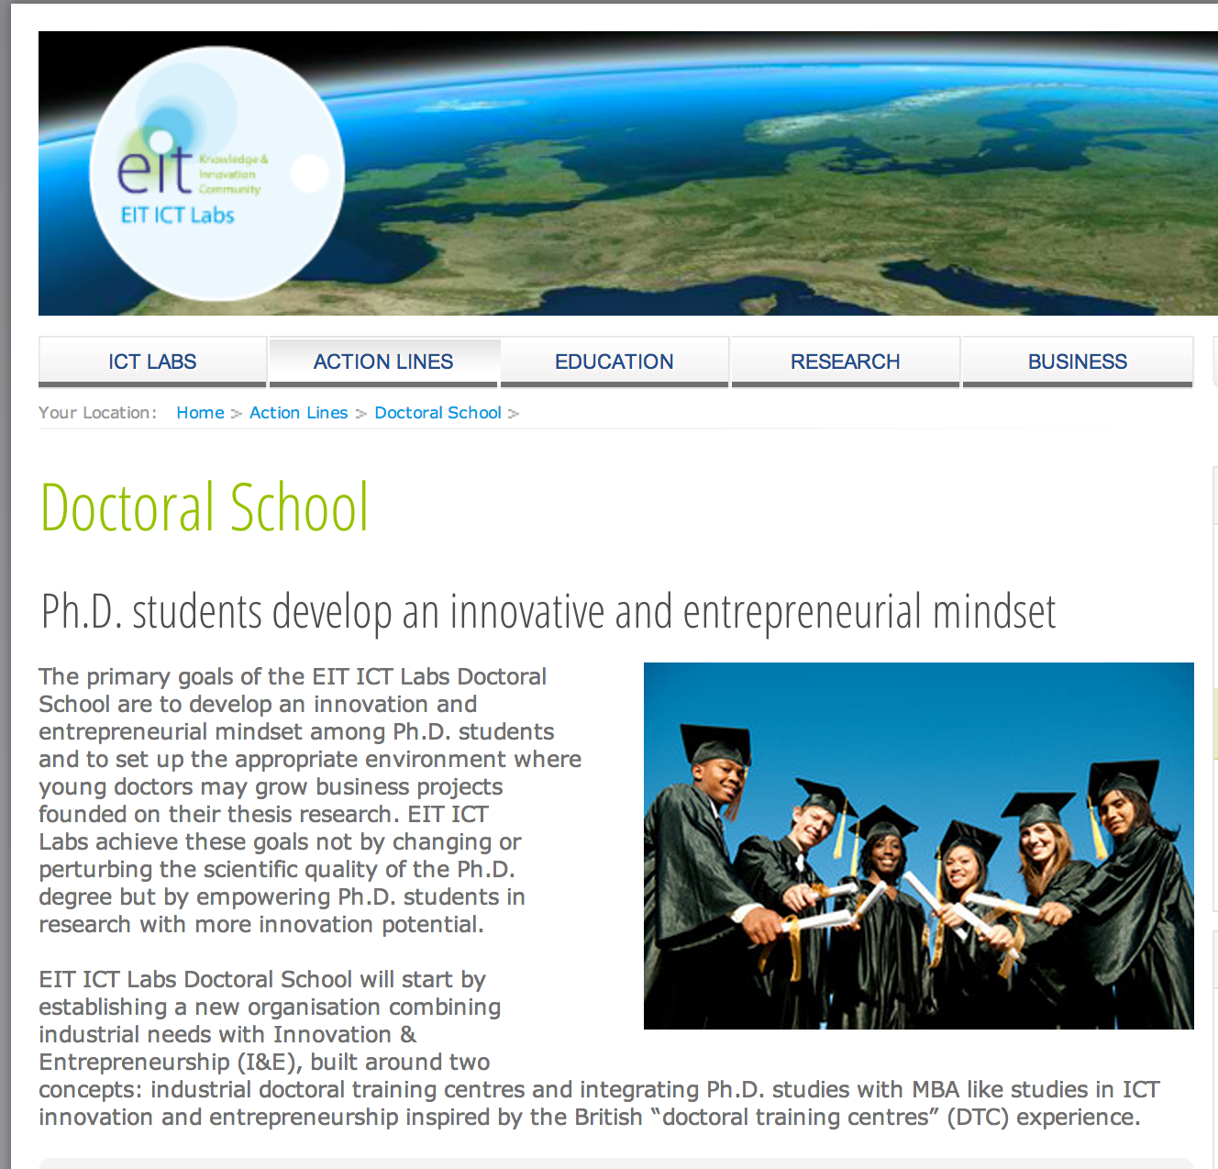
EIT ICT Labs Master School & Doctoral Programme

Slide 17
Helsinki Node

Slide 18
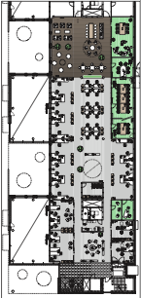
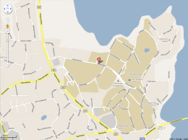


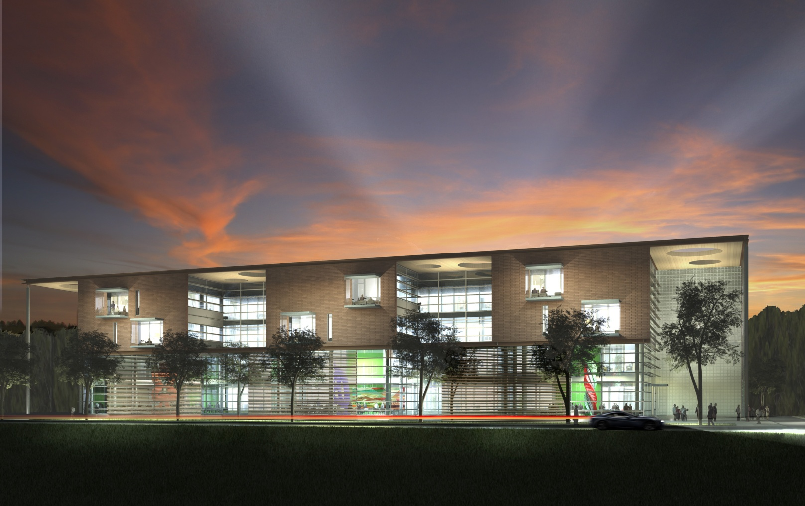




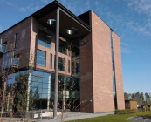


The Helsinki Co-Location Centre
  The Helsinki CLC is on Otaniemi Campus, a hotspot hosting many of our partners
  Office space: 800m² (starting September 2012)
  Proximity of EIT ICT Labs partners
      Open Innovation House: Nokia Research Centre, Helsinki Institute for Information Technology HIIT, AppCampus
      On Otaniemi Campus: Aalto University, VTT, Technopolis, CSC
‘Open Innovation House’ on
Otaniemi Campus

Slide 19
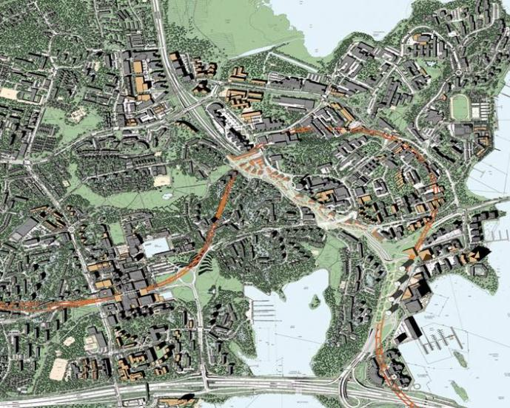









Our CLC is situated in the middle of the Finnish Innovation Hotspot
3
Otaniemi
Keilaniemi
Tapiola
T

Slide 20
Helsinki Node Core Partners
Aalto University
Nokia
VTT
Helsinki Node Affiliate Partners
Business ecosystem & Companies
    Centre for Scientific Computing (CSC)
    Hermia Ltd.
    Business Oulu
    Technopolis Ventures Ltd.
    Forum Virium
    Futurice Ltd.
Universities
    University of Helsinki
    University of Oulu
    University of Turku
    Åbo Akademi
    Tampere University of Technology
    University of Tampere

Slide 21



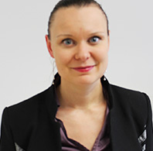
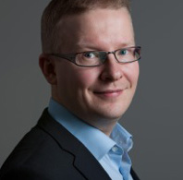



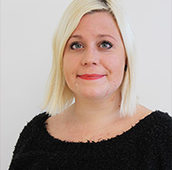

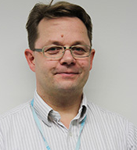
EIT ICT Labs Helsinki Team
Marko Turpeinen
Director
Kai Huotari
Co-location Centre Manager
Suvi Lavinto
Operations & Marketing Manager
Minna Pikkarainen
Business Dev.
Antti Aarnio
Head of Business Development
Martti Mäntylä
CSO EIT ICT Labs
Katri Sarkio
Doctoral School Coordinator
Päivi Saarinen
Financial Coordinator
Henna Sandvik
Assistant Controller
Soili Adolfsson
Assistant
Sami Jokela
Business Developer
Notes:
Core Partner representatives regularly visit the office and some of them will use the CLC at least half a day per week

Slide 22







EIT ICT Labs Helsinki Start-ups
Polqu
Smart Spaces
Health & Wellbeing
Notes:
Core Partner representatives regularly visit the office and some of them will use the CLC at least half a day per week

Slide 23
How To Get Involved?

Slide 24

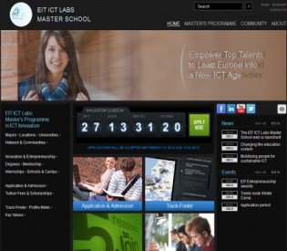

How to get involved in EIT ICT Labs?

Slide 25
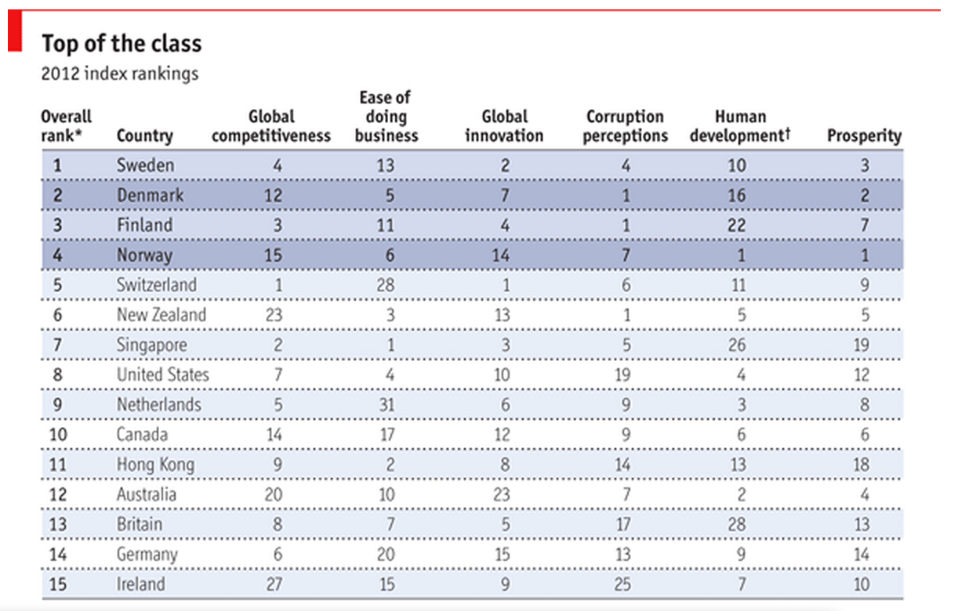

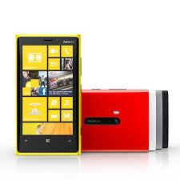
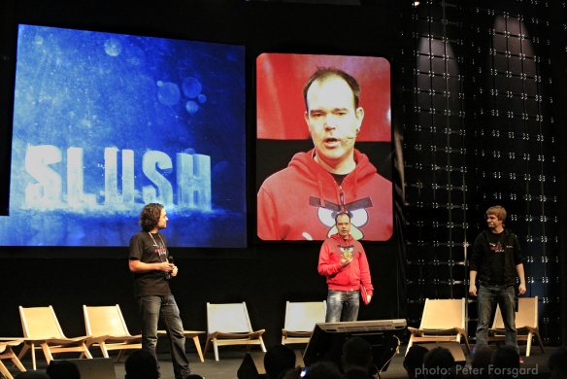
How to get involved in new EIT KICs?
Find a good consortium
Identify your expertise
Be active

Slide 26
Thank you for your attention!

