Slide 1
COST
Mihkel Koel
Tallinna Tehnikaülikool

Slide 2
Established in 1971
COST is an intergovernmental framework for European Cooperation in Science and Technology, allowing the coordination of nationally-funded research on a European level.
building a European Research Area (ERA):
a precursor of advanced multidisciplinary research,
anticipates and complements the activities of the EU Framework Programmes,
constituting a “bridge” towards the scientific communities of emerging countries.
increases the mobility of researchers across Europe and fosters the establishment of scientific excellence

Slide 3
COST Structure
COST is governed by the COST Member States.
COST Ministerial Conferences, which are held on average every five years.
Committee of Senior Officials (CSO) is the main decision-making body of COST. Each COST Member State appoints two representatives to the CSO, one of whom is usually the COST National Coordinator (CNC).
Executive Group of the CSO (JAF) -
COST National Coordinator (CNC) – Ülle Must
Domain Committee (DC) consist of experts nominated by the CNC. The DC is responsible for the quality control of the allocated Actions (assessment, monitoring, evaluation).
Management Committee (MC) - one for each Action - are formed by national experts nominated by the countries participating in the Action.
COST Office – the implementing agent for COST. It supports the scientific activities, e.g. the DCs and Actions’ activities, and implements CSO decisions.

Slide 5
COST Governance
Implemented by the COST Committee of Senior Officials (CSO), the main decision-making body responsible for the strategic development of COST.
On 19 March 2012, the CSO approved COST’s position paper ‘The COST Framework - A cornerstone of the ERA’ (COST 4106/12).
On June 2012, the CSO approved COST's ‘Action plan to increase inclusiveness in COST activities while fostering scientific excellence throughout Europe' (COST 4156/12).
The current CSO President is Dr Ángeles Rodríguez-Peña and the CSO Vice-President is Dr Primož Pristovšek.

Slide 6
COST Mission
COST enables break-through scientific developments leading to new concepts and products.
COST is a unique means for European researchers to jointly develop their own ideas and new initiatives across all scientific disciplines through trans-European networking of nationally funded research activities.
COST supports integration of research communities, leverages national research investments and addresses issues of global relevance.
COST is completely on voluntary basis and bottom-up initiative.

Slide 7
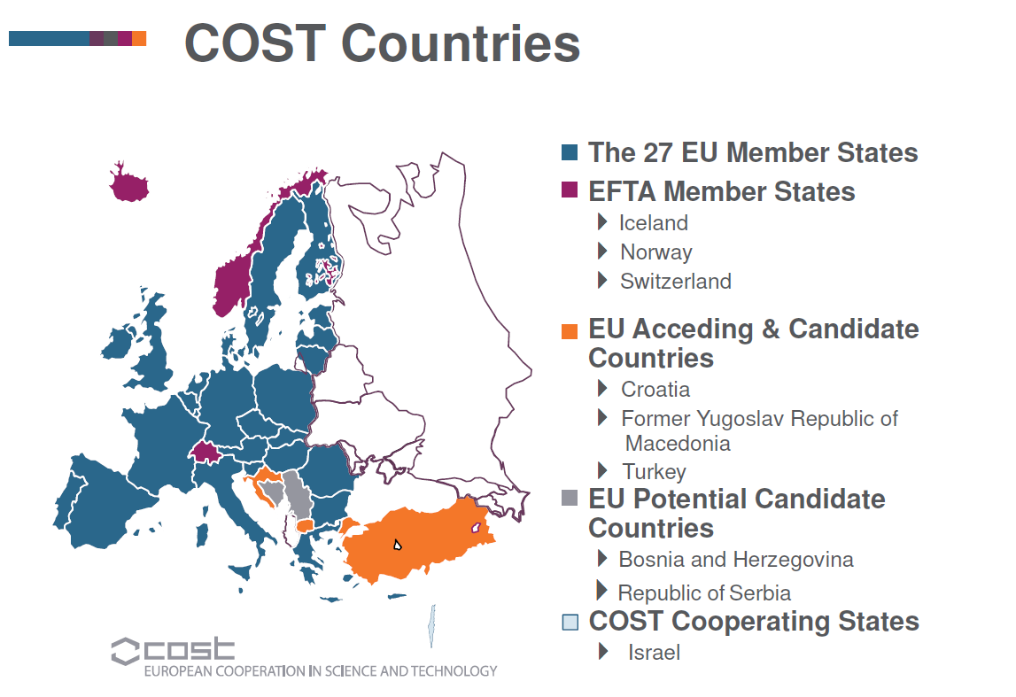

Slide 8
Voluntary approach
Participation of member states is based exclusively on a voluntary approach. They participate only in mutually agreed Actions, depending on their interest, relevance of joint research and shorter time needed to achieve envisaged results. The achieved results are the property of all participants, who have to provide full funding for agreed research and concerted activities themselves.
COST member states merely endorse the Actions by signing a Memorandum of Understanding, thus increasing their importance and providing moral support.

Slide 9
Domains
Key domains:
• Biomedicine and Molecular Biosciences
• Food and Agriculture
• Forests, their Products and Services
• Materials, Physics and Nanosciences
• Chemistry and Molecular Sciences and Technologies
• Earth System Science and Environmental Management
• Information and Communication Technologies
• Transport and Urban Development
• Individuals, Societies, Cultures and Health
In addition, Trans-Domain Proposals allow for broad, multidisciplinary proposals to strike across the nine scientific domains.

Slide 10
Domains and Actions
COST is based on projects, called COST Actions, centered around research projects in fields that are of interest to at least five COST countries. COST is a flexible, fast, effective and efficient tool to network and coordinate nationally funded research activities, bringing good scientists together under light strategic guidance.
COST Actions cover basic and pre-competitive research for peaceful purposes as well as activities of public utility.
Every COST Action has an objective, defined goals and clear deliverables. These are described in a Memorandum of Understanding, signed by participating COST Countries.

Slide 11
COST funding
The support will cover the costs of networking activities:
Meetings, conferences, workshops, (e.g. travel, subsistence, local organiser support);
Short-term scientific exchanges (STSM-s);
Training schools;
Publications and dissemination activities.
COST does not fund the research itself.

Slide 12
CMST Structure and Organisation
DC meetings:
Twice a year - DC hearings (new actions, raports on Actions)
Once a year – Action progress meeting (presentations from Actions)
COST Projects - Actions are networks centred around nationally funded research projects and includes in some cases research institutes from non-COST.
Management Committee (MC) of Action is responsible for all the scientific activities and the selection process declared in proposal.
The success of this Domain is proven by :
the increasing number of networks
the big number of activities within the Actions: scientific meetings, workshops, seminars, workshops for young scientists, exchanges of students (short-term scientific missions),...
the high quality of results and publications obtained.

Slide 13
Open Call
Two-stage process:
Submit a Preliminary Proposal by a set collection date. This Preliminary Proposal provides an overview of the proposed Action’s goal and its foreseen impact.
After evaluation, the top-ranked Preliminary Proposals are invited to submit a Full Proposal.
After assessment by external experts, the top-ranked Full Proposals are presented orally to the Domain Committee (DC Hearings). A final list is proposed for approval by the Committee of Senior Official .
Open Call Collection date:
Each collection date is announced in the Official Journal of the European Union a few months before the deadline. Usually twice a year.
For submissions in one of the nine COST Domains: 29 March 2013 at 17:00 Brussels time (GMT+1).

Slide 16
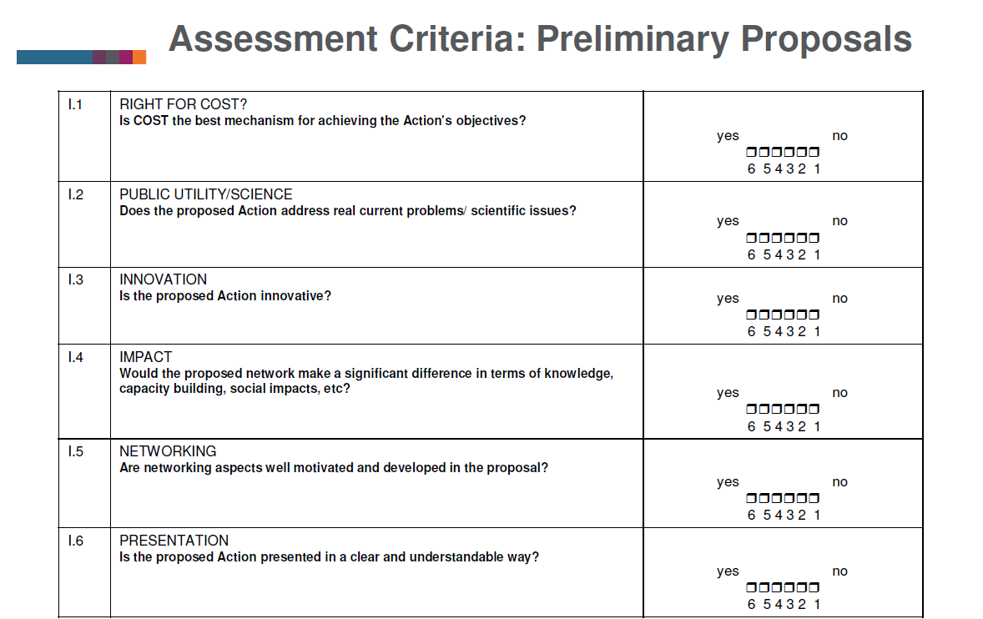

Slide 19
Chemistry and Molecular Sciences and Technologies (CMST)
CMST has the mission of fostering European expertise in discovering, understanding, producing and manipulating molecular species.
These research activities aim to develop experimental, theoretical and analytical tools to enhance the development of chemical transformations, reactivity and function.
The CMST aims to apply such knowledge and innovation to industrial processes and production.

Slide 20
CM1201 | Biomimetic Radical Chemistry | 06 December 2012 - 05 December 2016
CM1202 | Supramolecular photocatalytic water splitting (PERSPECT-H2O) | 22 November 2012 - 21 November 2016
CM1204 | XUV/X-ray light and fast ions for ultrafast chemistry (XLIC) | 25 February 2013 - 20 November 2016
CM1205 | Catalytic Routines for Small Molecule Activation (CARISMA) | 25 February 2013 - 20 November 2016
CM1206 | EXIL - Exchange on Ionic Liquids | 25 February 2013 - 20 November 2016
CM1207 | GLISTEN: GPCR-Ligand Interactions, Structures, and Transmembrane Signalling: a European Research Network | 25 February 2013 - 20 November 2016
TD1208 | Electrical discharges with liquids for future applications | 25 February 2013 - 20 November 2016
CM1203 | Polyoxometalate Chemistry for Molecular Nanoscience (PoCheMoN) | 09 November 2012 - 08 November 2016
CM1105 | Functional metal complexes that bind to biomolecules | 08 May 2012 - 07 May 2016
CM1104 | Reducible oxide chemistry, structure and functions | 19 April 2012 - 18 April 2016
CM1106 | Chemical Approaches to Targeting Drug Resistance in Cancer Stem Cells | 28 March 2012 - 27 March 2016
CM1101 | Colloidal Aspects of Nanoscience for Innovative Processes and Materials | 19 January 2012 - 18 January 2016

Slide 21
Very soon
25-26 of March 2013
CMST DC meeting in Tallinn
COST introduction on Estonian Chemical Society concil meeting in Institute of Chemistry at TTU (Akadeemia 15) at 13:00 by CMST DC Chair Prof Dieter Schinzer and COST science officer Dr Lucia Forzi

