Slide 1
Research Integrity
The good, the bad and the ugly!
Dr Maura Hiney, Health Research Board Ireland

Slide 2
Content
Some definitions
Research Integrity in context
Evidence on incidence and prevalence
The failure of self-regulation and peer review
The consequences of misconduct

Slide 3
“Research integrity” relates to the performance of research to the highest standards of professionalism and rigour, and to the accuracy and truth of the research record in publications and elsewhere.

Slide 4
Research Misconduct
Fabrication, falsification or plagiarism
in proposing, performing, or reviewing research, or in reporting research results.
(Common federal definition)

Slide 5
Definitions of FFP
Fabrication: making up results and recording or reporting them
Falsification: manipulating research processes or changing or omitting data
Plagiarism: appropriation of another person’s ideas, research results or words without giving appropriate credit
See ESF Code of Practice

Slide 6
Questionable research practices
Personal misconduct (intimidation, harassment, discrimination, misuse of funds…): undesirable or unacceptable, but not ‘scientific misconduct’
Bad research practices (data management, research procedures, publication related misconduct…); objectionable, harmful, but not basic infringement of scientific integrity
Minor misdemeanours (tampering with data, cutting cornes, omitting an unwelcome observation….); unacceptable infringements of scientific integrity
See OECD List

Slide 7
The link between ethics and integrity
RESEARCH INTEGRITY
Good Research Practice
Research Ethics
Publication Ethics
Proposal
Research/ Experimentation
Analysis
Dissemination
Ensures that:
the research is justifiable
the benefits outweigh the risks
the methodology is sound
participants will be adequately protected
Ensures:
that the research is reliable and objective
impartiality and independence
openness and honestly in analysis and reporting
upholding of duty of care to participants and colleagues
Ensures transparency:
in declaring funding sources
fairness in attributing authorship
honestly in reporting results and conclusions
ownership of ideas and intellectual property
Notes:
Research Ethics
Ensures that:
the research is justifiable
the benefits outweigh the risks
The methodology is sound
Participants will be adequately protected

Slide 8
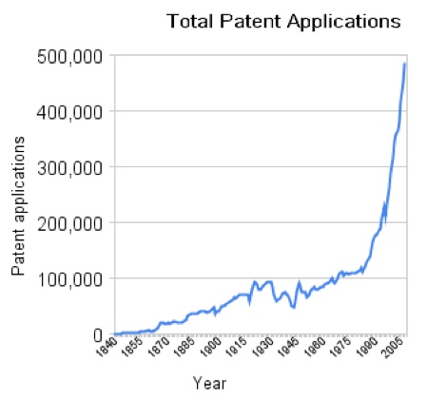
The context of research integrity
A steady rise in scientific ‘productivity’

Slide 9
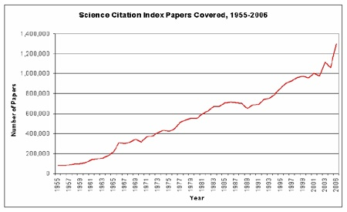
The context of research integrity
A steady rise in scientific publications and the pressure to publish

Slide 10
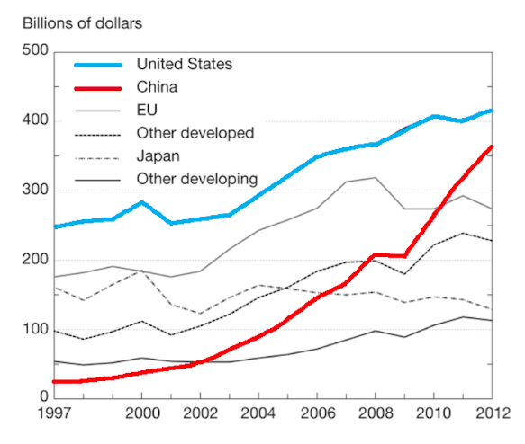
The context of research integrity
Increasing annual expenditure on R&D
1 of 100 public dollars in US spent on health research
In Europe approx. 1.75% of total government expenditure on R&D (GERD)
Research is a very much a public activity

Slide 11
Science and society are linked
Science and society are interconnected:
the public, as taxpayers, are major supporters and funders of research
public support is provided on the understanding that society will benefit from research
But continued public support requires credibility and trust:
Eurobarometer Survey (2010) – 58% of Europeans did not trust scientists to be truthful about controversial issues
Climategate – rigour and honesty of research not in doubt but the CRU failed to display the proper degree of openness and transparency

Slide 12
Excellent research is done by honest researchers – so why all the fuss about research integrity?

Slide 13
Assumptions about misconduct
Serious misconduct in research is rare
Self-regulation keeps improper behavior in check
Research misconduct is difficult to detect
Research misconduct cannot be prevented
Apart from misconduct, standards for integrity in research are high
Assumptions were based on common perceptions, not empirical evidence
All five can be questioned!
Slide courtesy of Prof Nick Steneck

Slide 14
Assumption 1: Rarity
How common are incidents of research misconduct?
2002 Survey by NIH in US
Survey of 7,760 mid- and early-career scientists
All NIH-supported
3,247 respondents; response rates:
- 52% (mid-career), 43% (early-career)
Asked them whether they had ever witnessed or participated in FFP or questionable research practices
Data courtesy of Prof Nick Steneck

Slide 15
Data courtesy of Prof Nick Steneck

Slide 16
Data courtesy of Prof Nick Steneck

Slide 17
Was that a once-off observation?
Geggie, J Med Ethics (2001)
Survey of 305 new medical consultants in UK (64% responded)
55.7% observed misconduct (FFP lower)
5.7% committed misconduct in the past
18% would commit in future
17% had research ethics training
Gardner et al, Contemporary Clinical Trials (2005)
Survey of 549 authors of pharmaceutical clinical trials in Cochrane database from 1998-2001 (64% response)
1% reported target article misrepresented the research
5% reported fabrication in a study they had participated in over the last 10 years
17% knew personally of fabrication in a study over the last 10 years
Slide courtesy of Prof Nick Steneck

Slide 18
Meta-analysis of survey data
Fanelli, PLOS-One (2009)
Systematic review of 21 surveys on levels of misconduct over past 25 years (pooled weighted averages)
Own behaviour
1.97% admitted fabrication, falsification or data modification at least once
33.7% admitted other questionable research practices
Witnessed in colleagues
14.1% witnessed fabrication, falsification or data modification at least once
72% witnessed other questionable research practices
Misconduct reported more frequently by medical/pharmacological researchers than others

Slide 19
2010 survey of intervening in misconduct
Koocher and Keith-Spiegel (2010) – survey of 2,599 NIH PIs

Slide 20
Question How can misconduct be that prevalent, if the checks and balances work? If someone changes data, makes it up or copies it from another scientist, surely that will be spotted by colleagues, peer reviewers or journal editors?

Slide 21
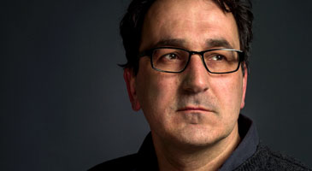
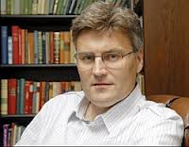
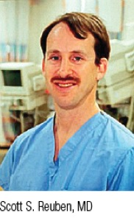
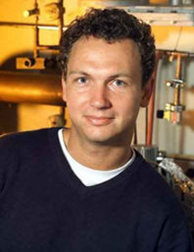
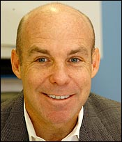
Not necessarily!
Self-regulation keeps improper behavior in check?
Darsee published 100 papers with falsified data over 14 years
Staple published fraudulent data between 2004-2010
Research misconduct is difficult to detect?
Hwang could not have completed work in the time reported
Sudbø, trial not started, patients did not exists, data repeated
Reuben’s data, described as ‘pure fiction’, highly cited
Research misconduct cannot be prevented?
Schön’s co-author/mentor did not check experiments or data
Poehlman’s MD co-author did not oversee clinical results
Part of slide courtesy of Prof Nick Steneck

Slide 22
It is not just about protecting the scientific record
Werner Bezwoda (1995)
Key trial of the effectiveness of high dose chemo and bone marrow transplants for breast cancer based on faked data
Over 30,000 women underwent expensive, debilitating and often fatal transplants (20%)
Study protocol written 9 years after the study began
Trial deaths not reported
Not discovered until 2001
Andrew Wakeman (1998)
Seminar paper on the link between MMR vaccination, gastrointestinal problems and autism
Without vaccination incidence of whooping cough, measles, meningitis greatly increased and many childhood fatalities
Timelines falsified to create the appearance of cause and effect in study subjects (12 children!)
Not uncovered for 13 years

Slide 23
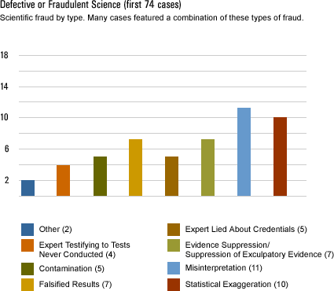
Forensic science misconduct
Data courtesy of the Innocence Project

Slide 24
Collateral damage to careers
There is collateral damage to the careers of post-doctoral and other junior researchers working with or publishing with someone who has been found guilty of misconduct.
A young scientist’s reputation is tethered to the successes and failures of their mentor, and when that mentor is found guilty of misconduct, that disciple will also be viewed with suspicion.
It can take five to seven years to recover from an association with misconduct, even if a researcher is totally innocent of any wrong-doing*
*Observation courtesy of Prof John Ioannidis, Stanford University

Slide 25
Public response to misconduct
Relationship between number of media reports on research
misconduct, and public confidence in science and scientists
Vetenskap & Allmänhet (2014) - based on 356 news reports on research misconduct

Slide 26
Misconduct has consequences Not a victimless crime
It damages the research record by contaminating it with fraudulent data that may be difficult to eradicate
It hurts patients, who may receive incorrect/fatal treatments
It hurts researchers and disciplines, which are tarnished by fraudulent scientists in their midst
It hurts the public, whose faith in research is undermined
It squanders public money and the efforts of some of the worlds best minds
More than anything, it hurts science, when you can’t trust the data presented or the person presenting it

Slide 27
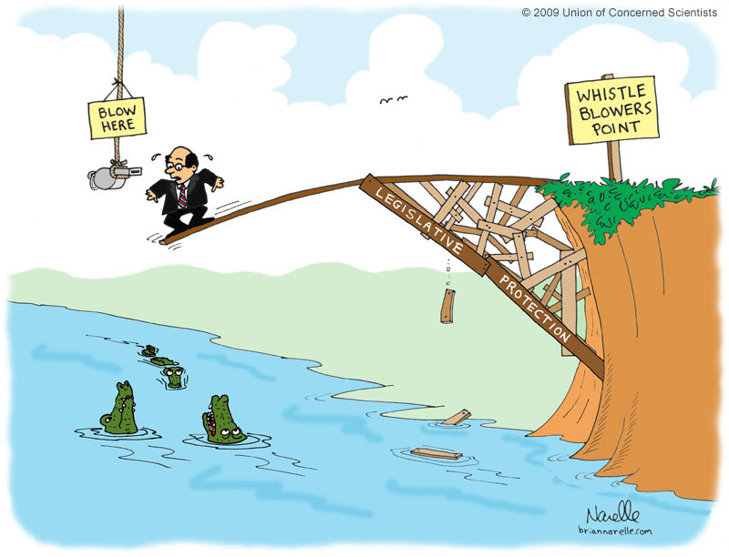
What about whistle-blowers?
Sometimes seen as selfless martyrs for public interest and organizational accountability
More often viewed unfairly as "traitors" or "defectors"
Probable that many people do not consider blowing the whistle because of fear of retaliation or of losing their credibility or job
Key to a fully functioning RI system so MUST be protected

Slide 28
Everyone needs to be responsible
Koocher and Keith-Spiegel (2010) - based on 2,193 reported incidences

Slide 29
Is it possible to change the culture?
Crain et al, Sci Eng Ethics (2012)
Survey of NIH researcher perceptions of research climate in their university/department AND frequency of FFP/QRP (N=1,267; 50%)
Research climate predictors: regulatory quality, RI support, integrity norms, integrity inhibitors, advisor-advisee relations, expectations etc.
Key Finding
The more positive the organisational research climate, the higher the likelihood of desirable research practices and the lower the likelihood of undesirable research practices
The findings are clear that misconduct is not about dealing with a few "bad apples" but about tackling organisational research climate issues
You cannot have excellent research if you do not have a climate that fosters research integrity

Slide 30
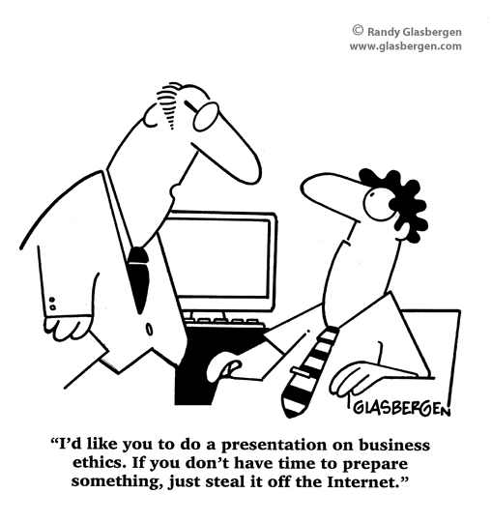
Thank you for your attention

Slide 31
References
Gerald P. Koocher & Patricia Keith-Spiegel (2010) Peers Nip Misconduct in the Bud. Nature. 466, 438-440
Supplementary material: http://www.ethicsresearch.com/images/Method_Results_July_22_2010_a.pdf
Danielle Fanelli (2009) How Many Scientists Fabricate and Falsify Research? A Systematic Review and Meta-Analysis of Survey Data. PLoS ONE 4(5): e5738. doi:10.1371/journal.pone.0005738 http://www.plosone.org/article/info%3Adoi%2F10.1371%2Fjournal.pone.0005738
D Greegie (2001) A survey of newly appointed consultants' attitudes towards research fraud. J Medical Ethics, 27:344-346
Gardner W, Lidz CW, Hartwig KC (2005) Authors' reports about research integrity problems in clinical trials. Contemporary Clinical Trials. 26(2):244-51

